Slide 1
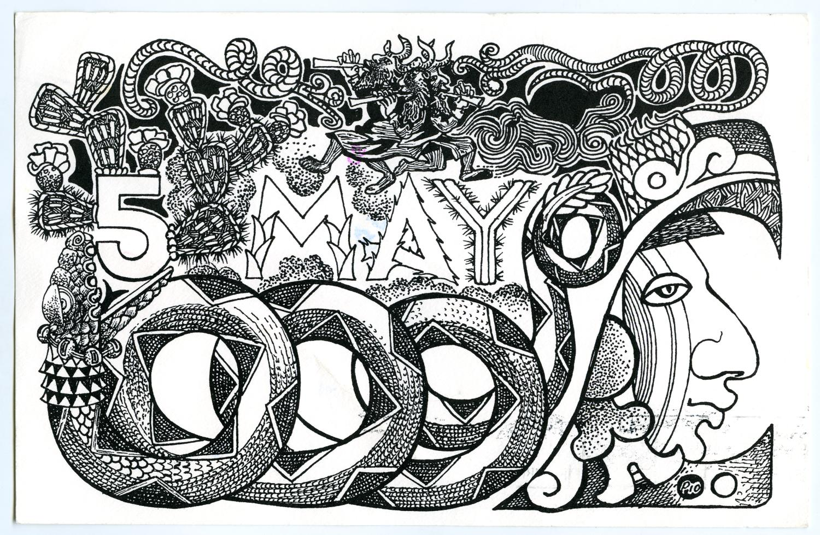

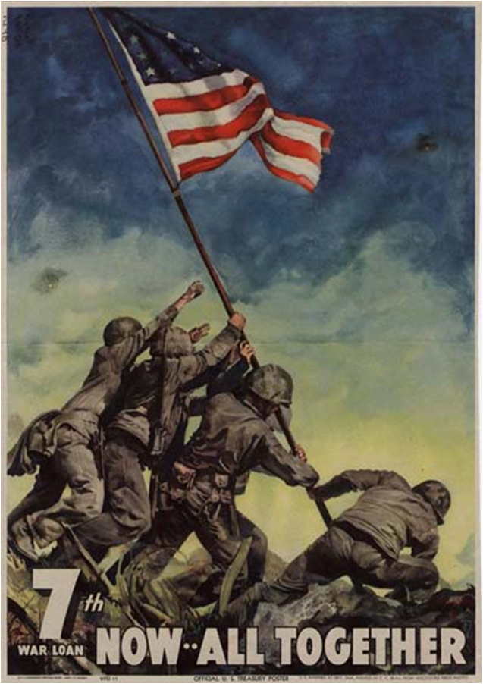
Human Statues to the Progressive Movement
Beall, C. C. (Cecil Calvert), 1892-1967. 7th War Loan: now--all together., poster, 1945; [Washington D.C.]. (https://digital.library.unt.edu/ark:/67531/metadc578/, University of North Texas Libraries, UNT Digital Library, https://digital.library.unt.edu; crediting UNT Libraries Government Documents Department.
https://education.texashistory.unt.edu

Slide 2
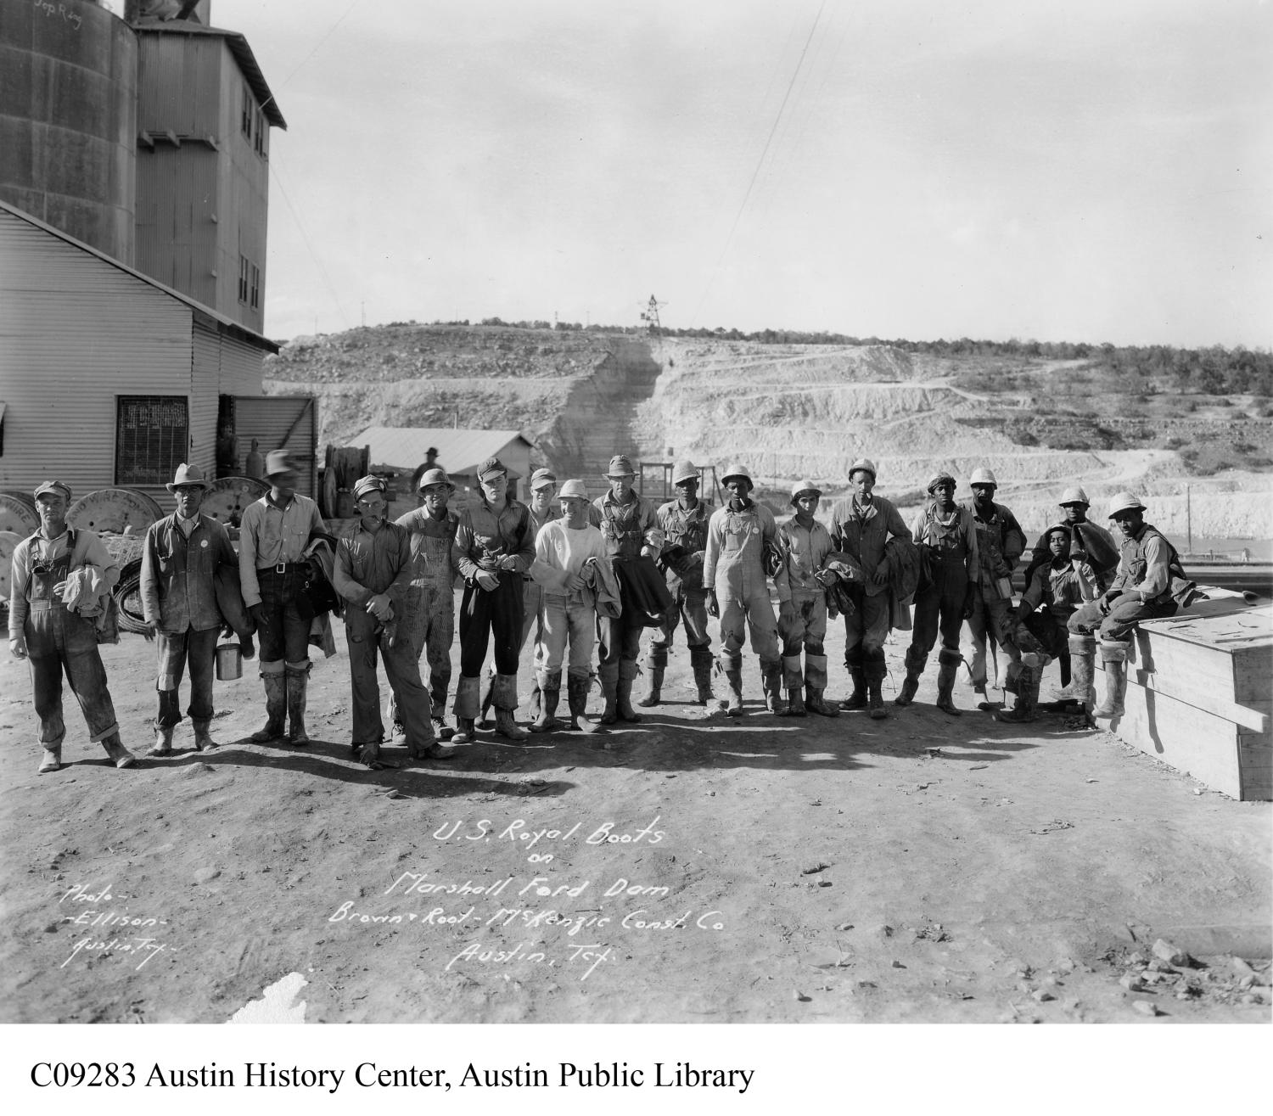
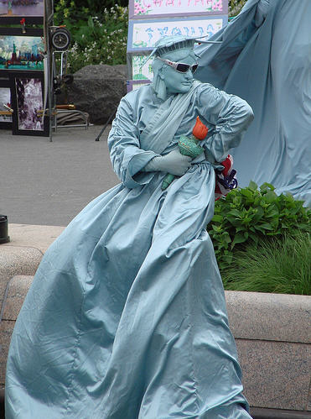
Human Statues to the Progressive Movement
Human statue of Liberty at Battery Park in New York, photo courtesy of Sebastián Ruggeri.
https://education.texashistory.unt.edu

