Slide 1
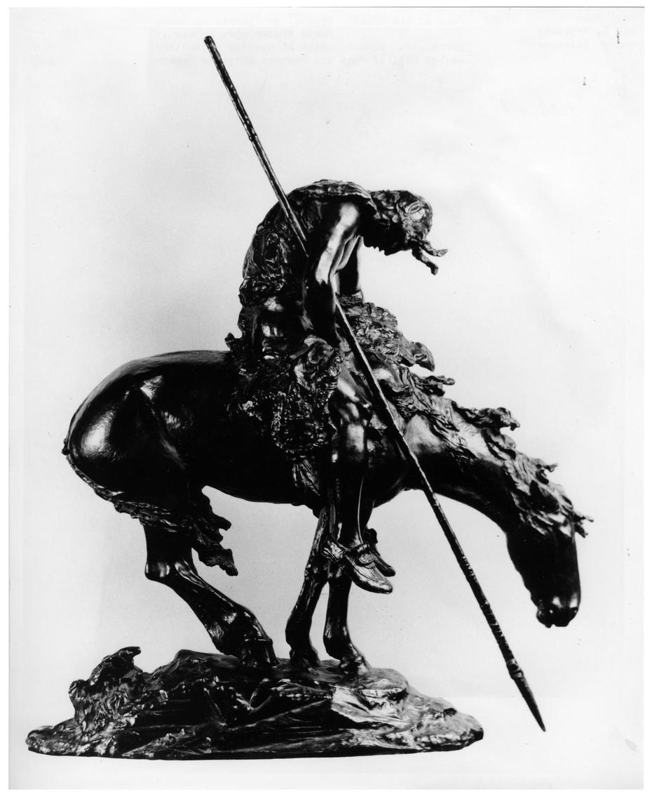
Native Americans
Multiple Choice Game
James Earl Fraser
End of the Trail

Slide 2
What type of shelter did the Plains Indians use?
Igloos
Caves
Tepees
Wickiups
A
B
C
D

Slide 3
The answer is tepees!
[Indians sitting near teepees], Photograph, University of North Texas Libraries, The Portal to Texas History; crediting University of Texas at Arlington Libraries, Arlington, Texas.

Slide 4
What would Native Americans often wear on their heads?
Feathers
Cowboy hat
Leaves
Baseball Cap
A
B
C
D

Slide 5
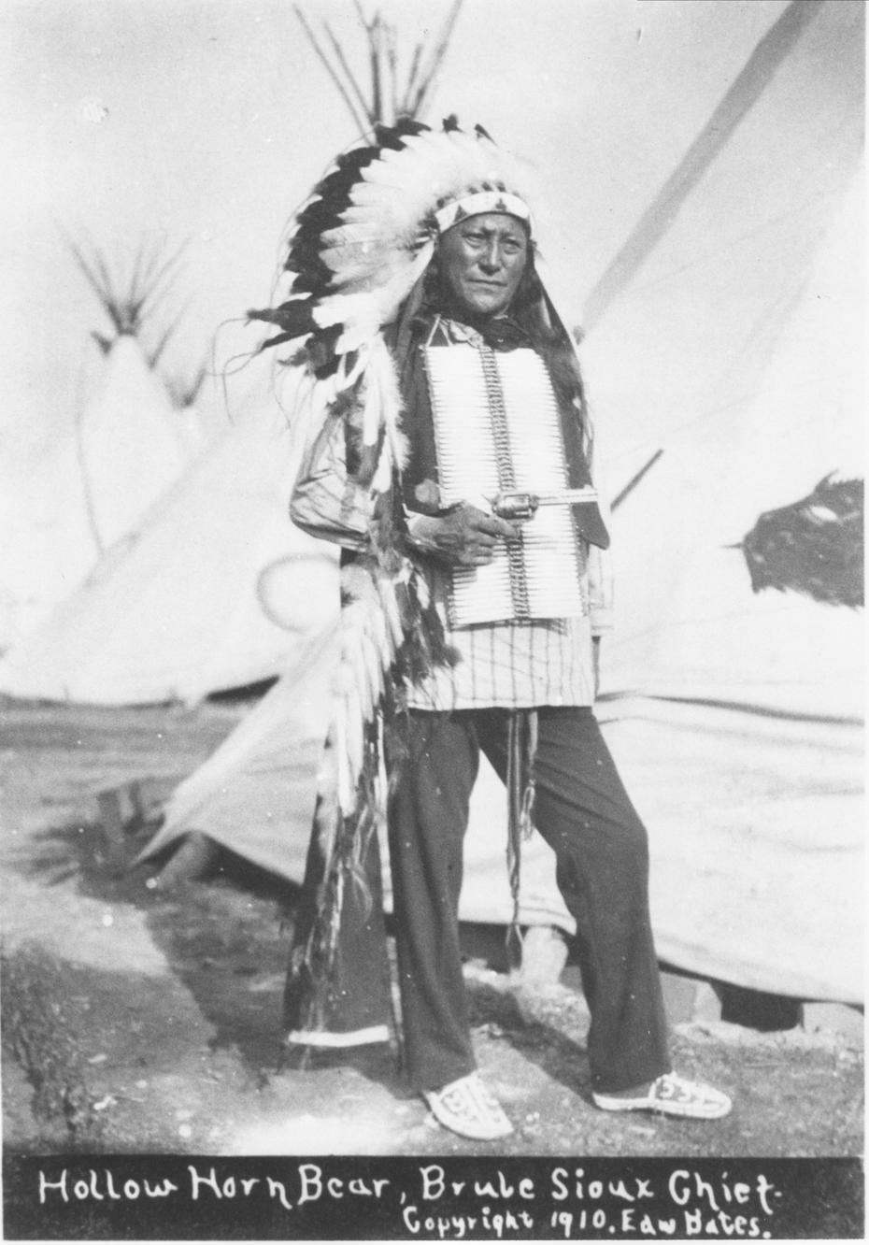
The answer is ‘Feathers’!
Edward Bates. Hollow Horn Bear, Photograph, University of North Texas Libraries, The Portal to Texas History ; crediting Tarrant County College NE, Heritage Room, Hurst, Texas.

Slide 6
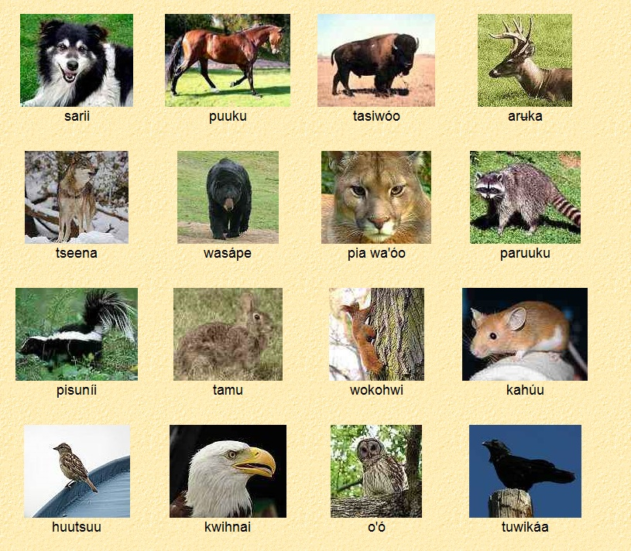
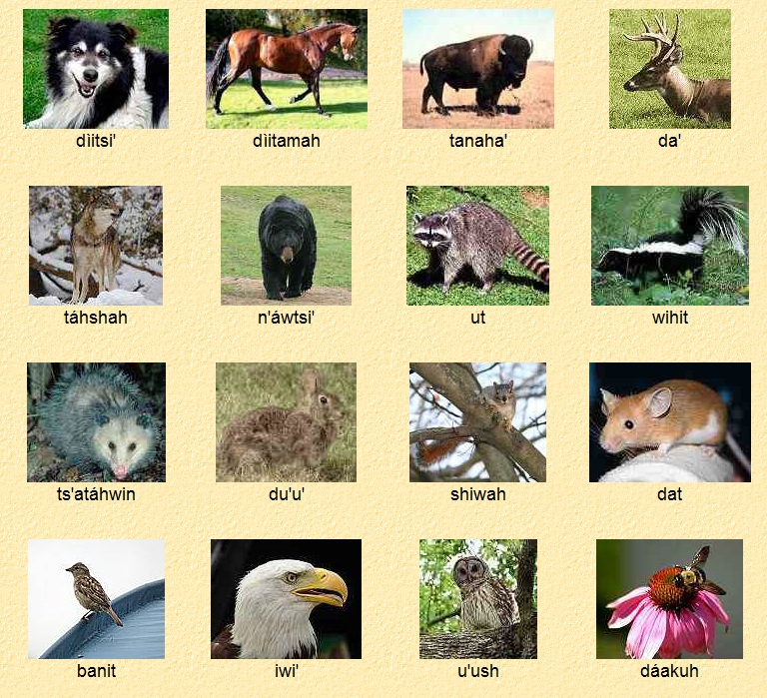
Practice speaking Caddo
"t'aybaw'ah" (tie-bow-ah)
means
"see you later”

Slide 7
When eating buffalo, what part would the Native Americans NOT eat?
Nose
Brain
Kidneys
Flesh
A
B
C
D

Slide 8
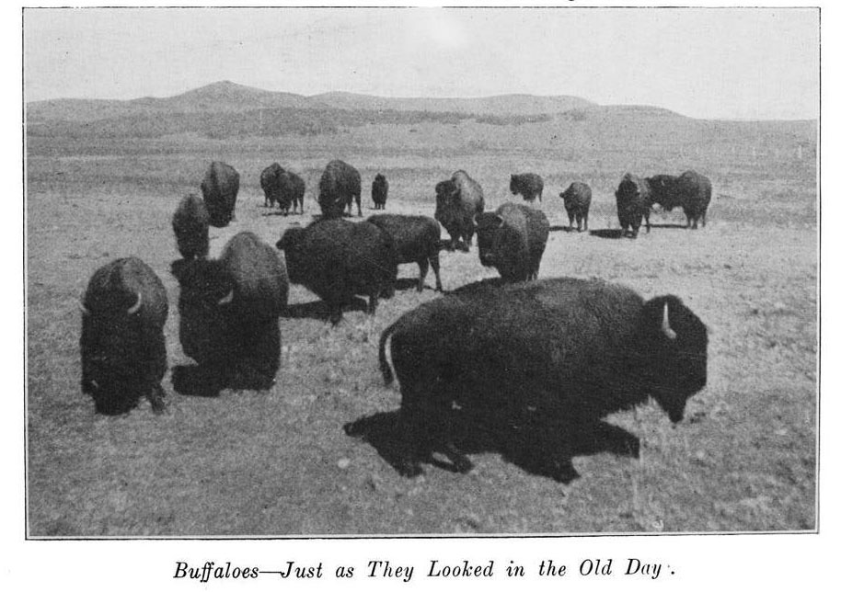
The answer is kidneys!
Click on the photo to discover
“How Many Ways Can You Use a Buffalo.”
Dixon, Billy. Life and adventures of "Billy" Dixon, of Adobe Walls, Texas panhandle; a narrative in which is described many things relating to the early Southwest, with an account of the fights between Indians and buffalo hunters at Adobe Walls and the desperate engagement at Buffalo Wallow, for which Congress voted the medal of honor to the survivors. Comp. by Frederick S. Barde., Book, 1914

Slide 9
What slang word do people commonly call Native Americans?
Astronauts
Indians
Cowboys
Buffalo Soldiers
A
B
C
D

Slide 10
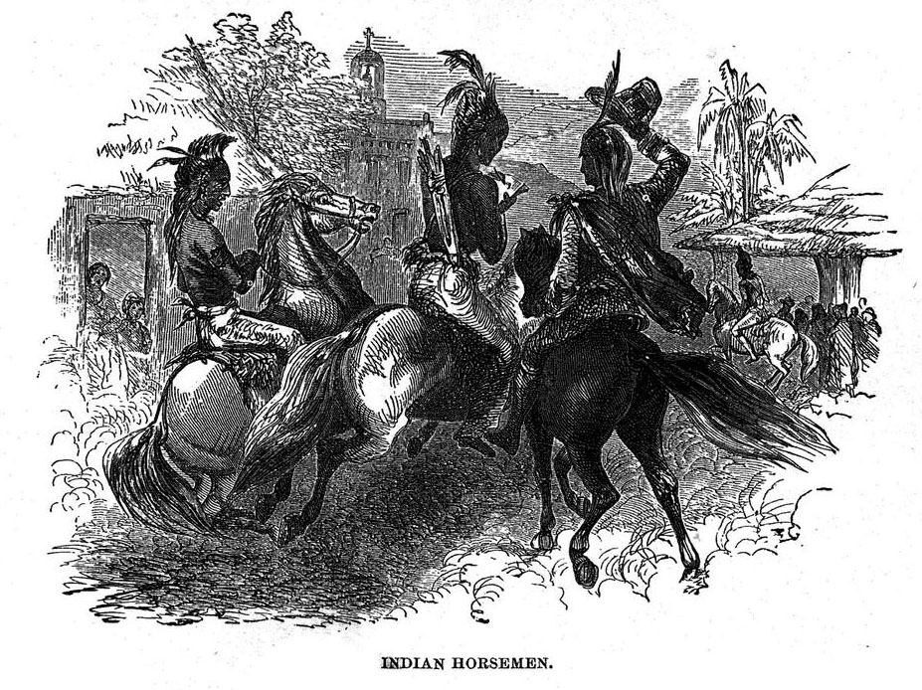
The answer is Indians!
Thrall, Homer S.. A pictorial history of Texas, from the earliest visits of European adventurers, to A.D. 1879. Embracing the periods of missions, colonization, the revolution the republic, and the state; also, a topographical description of the country ... together with its Indian tribes and their wars, and biographical sketches of hundreds of its leading historical characters. Also, a list of the countries, with historical and topical notes, and descriptions of the public institutions of the state., Book, 1879

Slide 11
What is the dance called to “bring the sun back”?
Sun Twist
Sun Jump
Sun Dance
Sun Hop
A
B
C
D

Slide 12
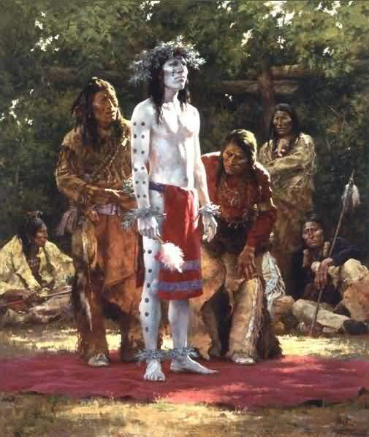
The answer is Sun Dance!
Performance :
Sun Dance. American Indian Dances. 1958. Smithsonian Center for Folklife and Cultural Heritage.
Painting :
Howard Terpning, Prepare For Sun Dance

Slide 13
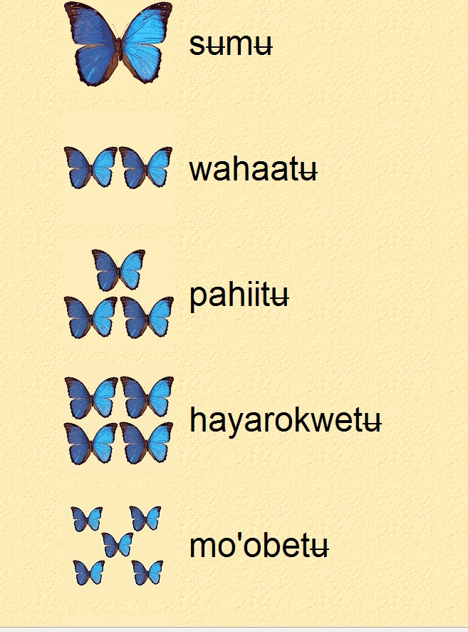
Practice speaking Comanche
"ura" (ur-ah)
means
"thank you."

Slide 14
Where do the Caddo live?
Plains
Mountains
Gulf Coast
Panhandle
A
B
C
D

Slide 15
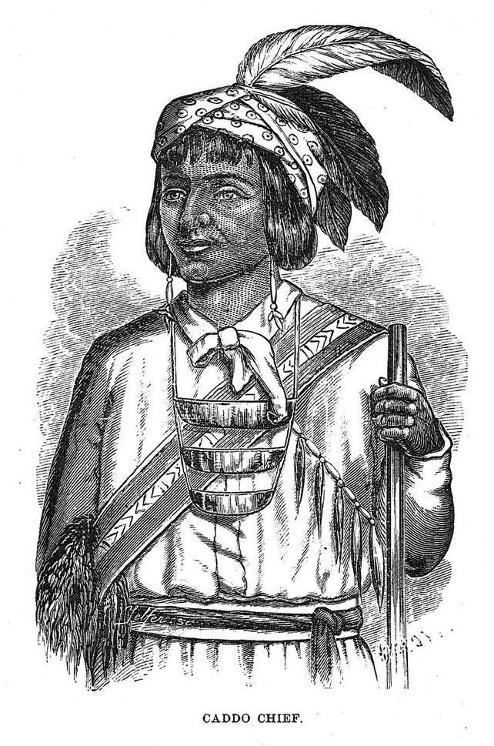
The answer is Plains!
Thrall, Homer S.. A pictorial history of Texas, from the earliest visits of European adventurers, to A.D. 1879. Embracing the periods of missions, colonization, the revolution the republic, and the state; also, a topographical description of the country ... together with its Indian tribes and their wars, and biographical sketches of hundreds of its leading historical characters. Also, a list of the countries, with historical and topical notes, and descriptions of the public institutions of the state., Book, 1879

Slide 16
What did the Caddo eat?
Corn
Deer
Pumpkins
All of the Above
A
B
C
D

Slide 17
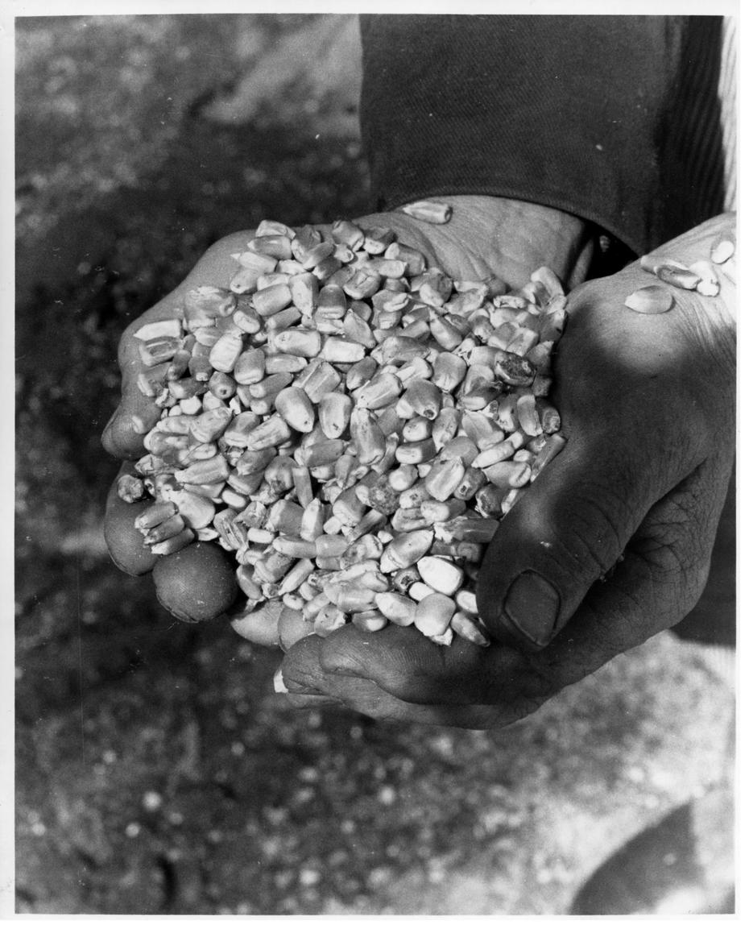
The answer is all of the above!
[Handful of corn], Photograph, n.d.; digital image, University of North Texas Libraries, The Portal to Texas History ; crediting Cattle Raisers Museum, Fort Worth, Texas.

Slide 18
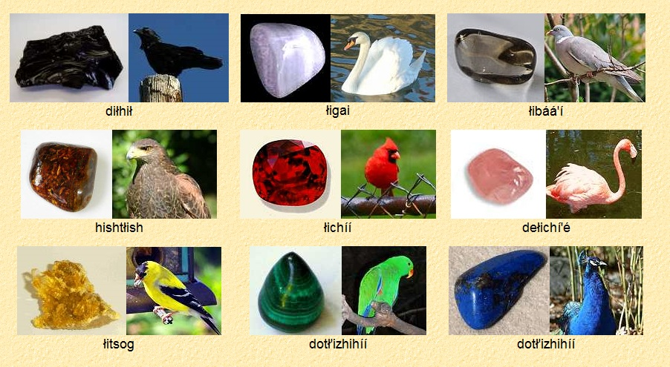
Practice speaking Apache
"ash"
(rhymes with 'gosh')
means
"friend"

