Slide 1

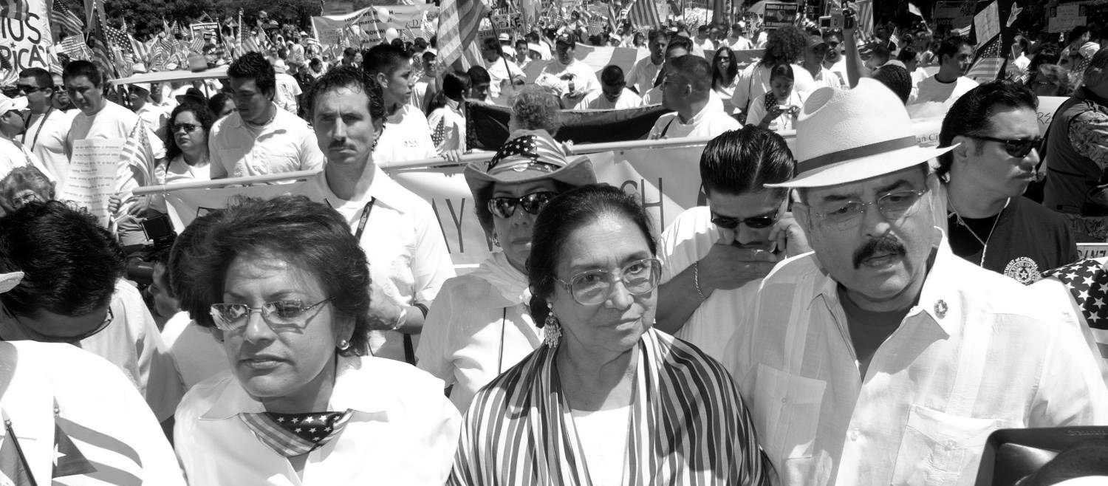
History Snapshots:
Mount Up! US Cavalry Equipment, 1910-1920
Cavalrymen carried a small amount of essential equipment; weight was always a concern.
Note how the equipment was harnessed on the horse.
Cavalry horses had their training completed by their troopers. This did much to build a bond between rider and mount, greatly helping the trooper to carry out his orders.
The expansive and sparsely populated West necessitated cavalry to maintain security.
https://education.texashistory.unt.edu

Slide 2
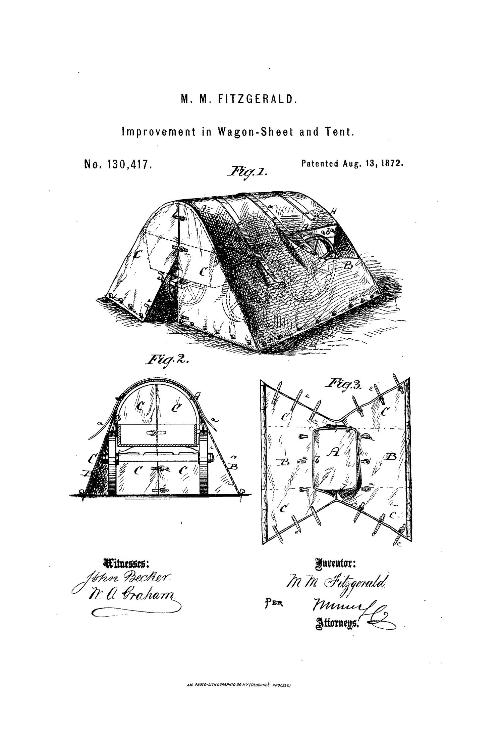
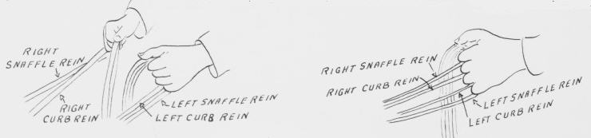
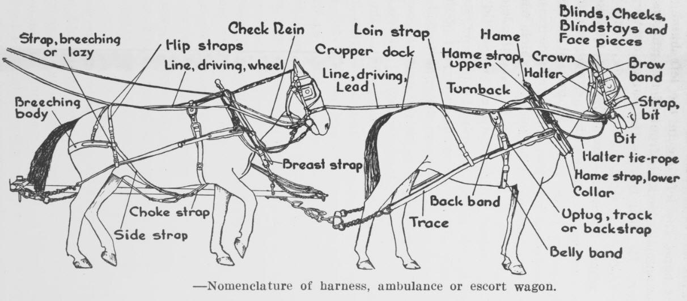
History Snapshots:
Mount Up! Reining up the Horses
Smithers, W. D. (Wilfred Dudley), 1895-1981.. Types of cavalrymen, their mounts and equipment 1916-1921. Picture, Artwork, 1920; digital image, (http://texashistory.unt.edu/ark:/67531/metapth11923); crediting The Archives of the Big Bend, Alpine, Texas.
Smithers, W. D. (Wilfred Dudley), 1895-1981.. Nomenclature of harness, ambulance, or escort wagon. Picture, Artwork, n.d.; digital image, (http://texashistory.unt.edu/ark:/67531/metapth11935); crediting The Archives of the Big Bend, Alpine, Texas.

Slide 3
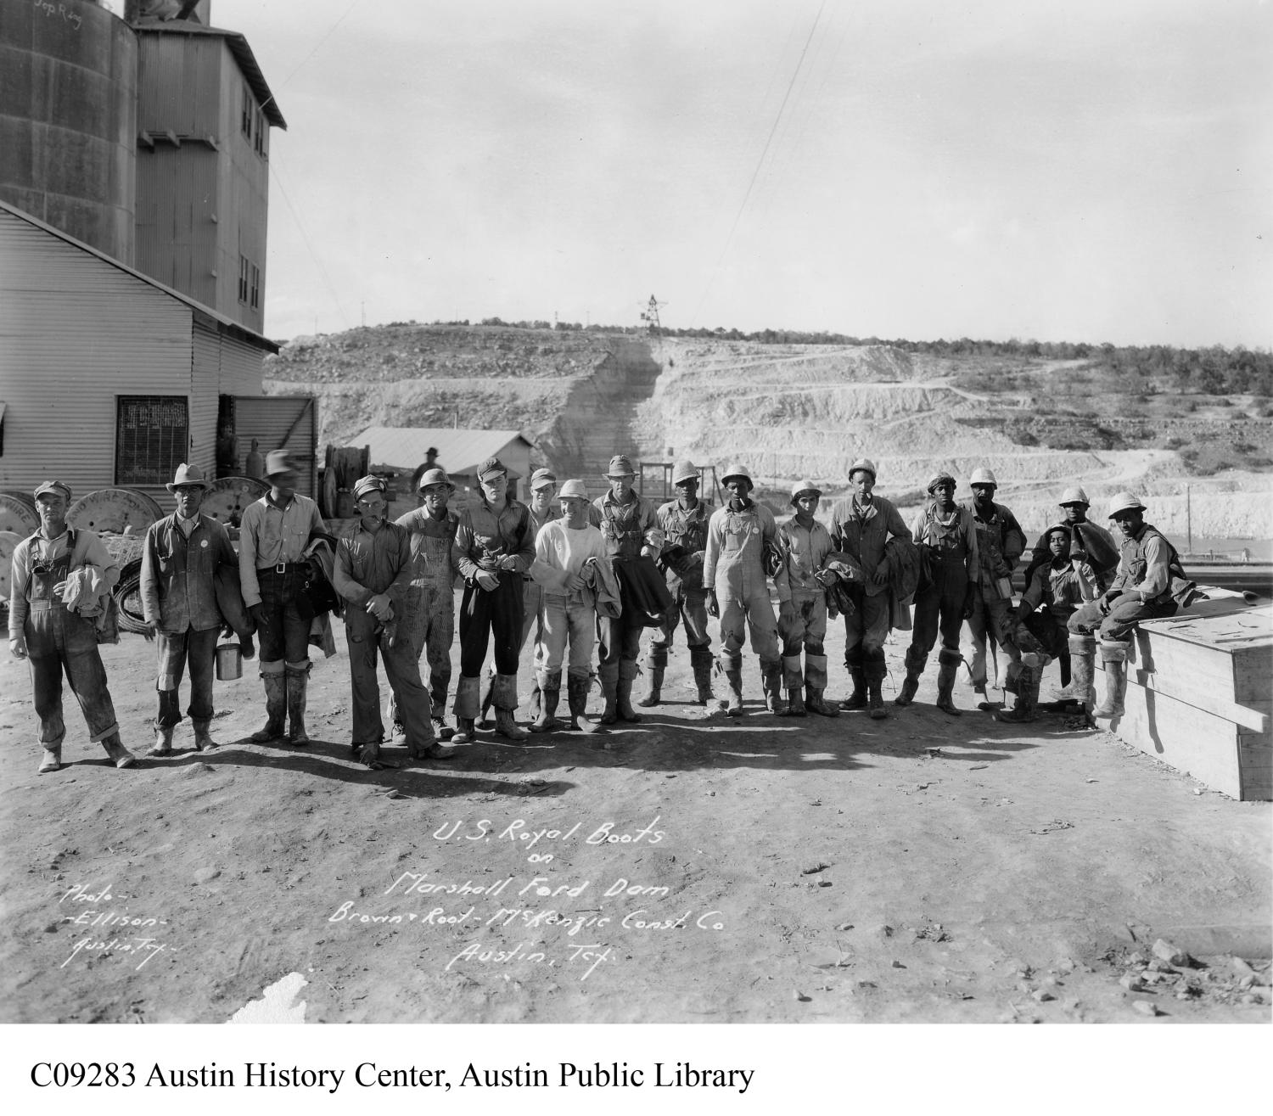
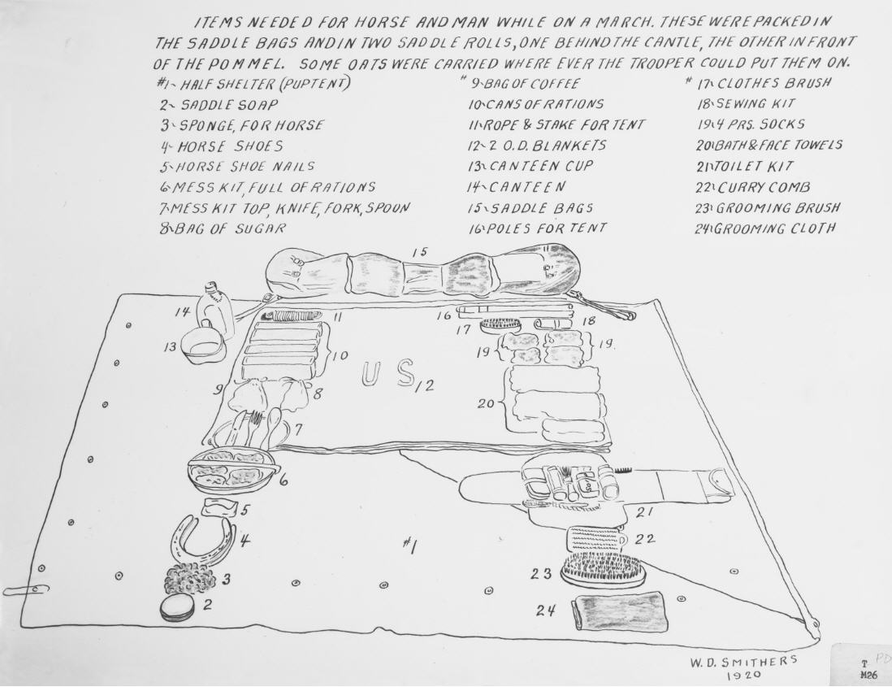
History Snapshots:
Mount Up! Bring your Gear
Smithers, W. D. (Wilfred Dudley), 1895-1981. Items needed for horse and man while on a march. Picture, Artwork, 1920; digital image, (http://texashistory.unt.edu/ark:/67531/metapth11939) ; crediting The Archives of the Big Bend, Alpine, Texas.
https://education.texashistory.unt.edu

Slide 4
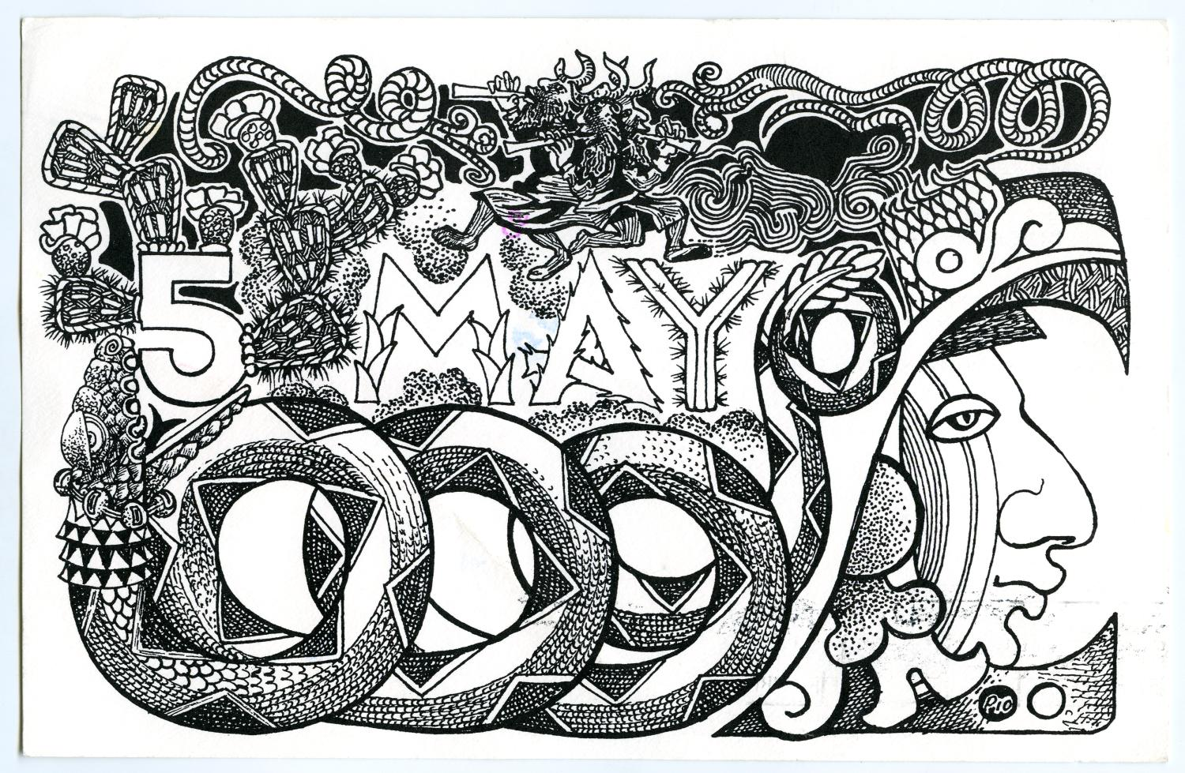
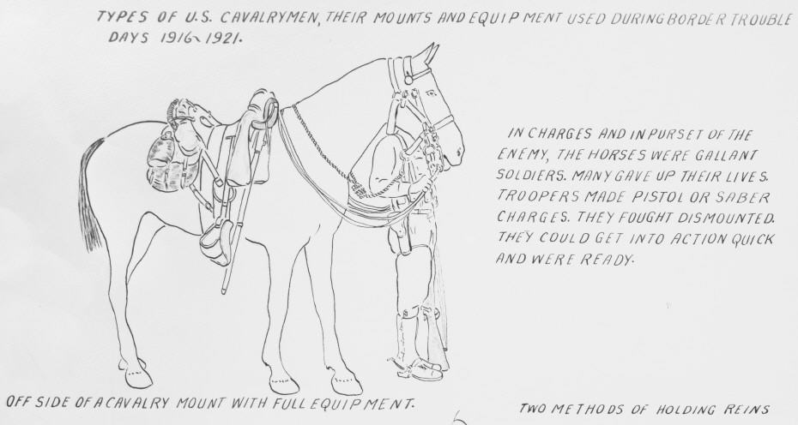
History Snapshots:
Mount Up! Saddled up with Full Equipment
Smithers, W. D. (Wilfred Dudley), 1895-1981.Types of cavalrymen, their mounts and equipment 1916-1921. Picture, Artwork, 1920; digital image, (http://texashistory.unt.edu/ark:/67531/metapth11923); crediting The Archives of the Big Bend, Alpine, Texas.
https://education.texashistory.unt.edu

Slide 5
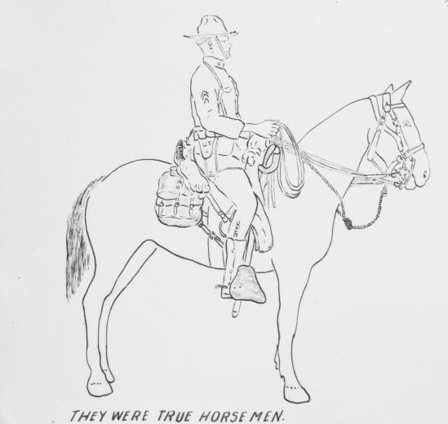
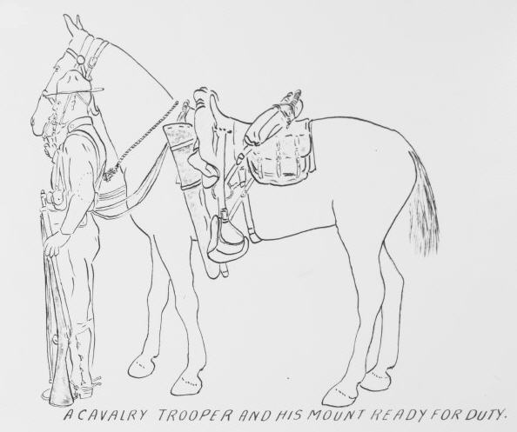
History Snapshots:
Mount Up! Ready for Duty
Smithers, W. D. (Wilfred Dudley), 1895-1981.Types of cavalrymen, their mounts and equipment 1916-1921. Picture, Artwork,1920; digital image, (http://texashistory.unt.edu/ark:/67531/metapth11923); crediting The Archives of the Big Bend, Alpine, Texas.
https://education.texashistory.unt.edu

Slide 6
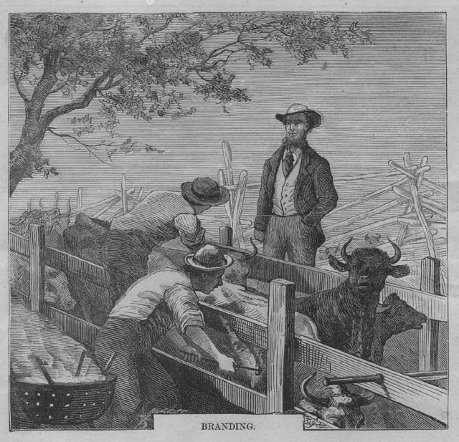
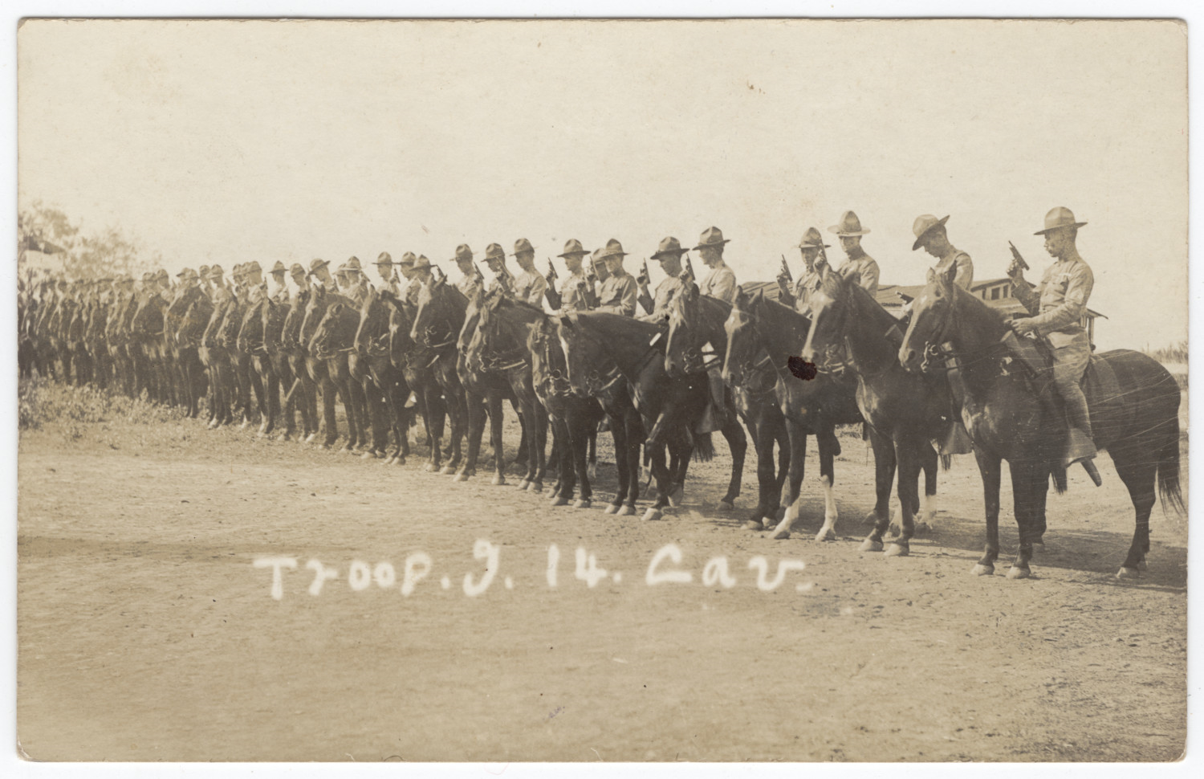
History Snapshots:
Mount Up! Troop ‘J’ 14th Cavalry
Troop ‘J’ 14th US Cavalry 1911. This image was taken shortly after the US Army adopted the 1911 Colt .45 Automatic Pistol. The 1910s-1920s marked a period of transition from mounted to motorized cavalry.
Troop J, 14th Cavalry, Ft. McIntosh], Photograph, ca. 1911; digital images, (http://texashistory.unt.edu/ark:/67531/metapth13298);
crediting Laredo Public Library, Laredo, Texas.
https://education.texashistory.unt.edu

