Slide 1

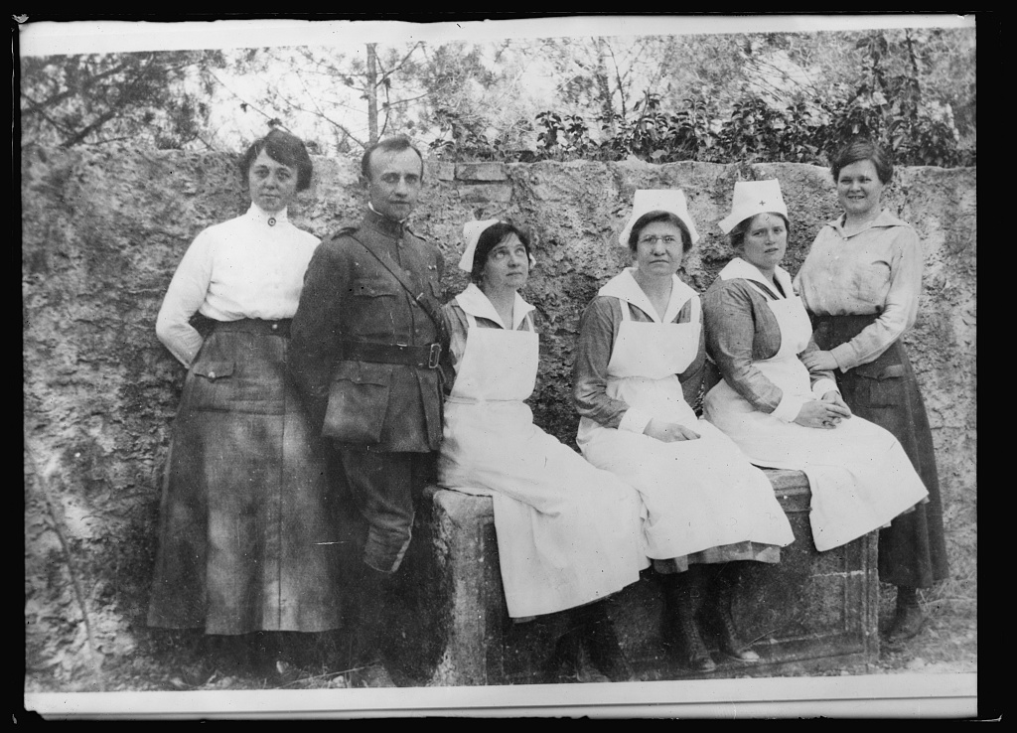
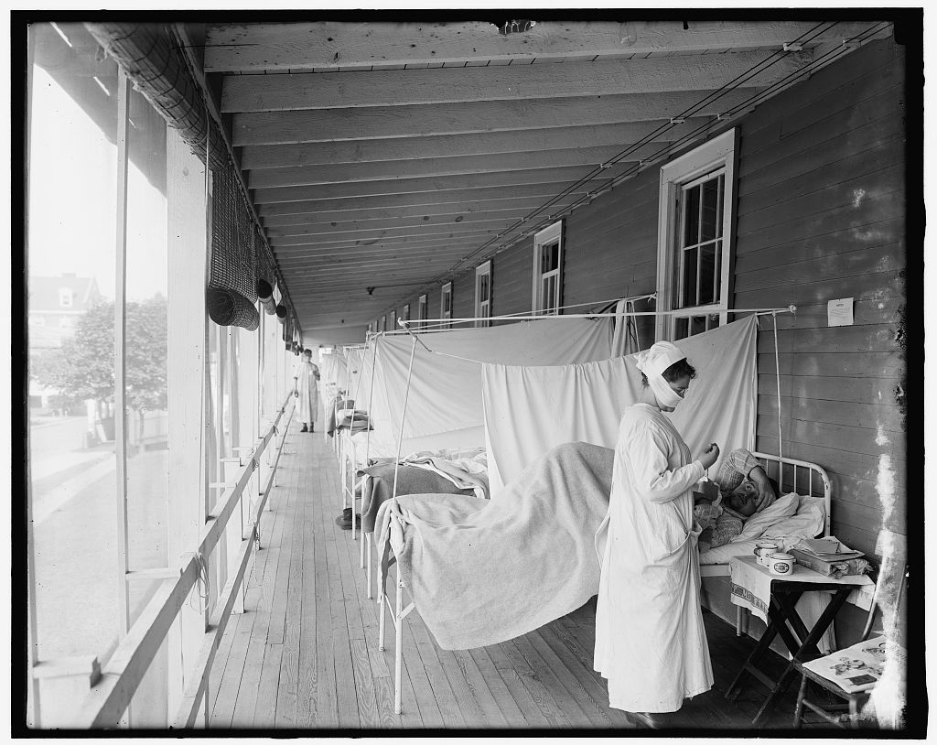
History Snapshots:
The Influenza Pandemic of 1918-1919
Images from this page are from Library of Congress’ Digital Collections
https://education.texashistory.unt.edu

Slide 2

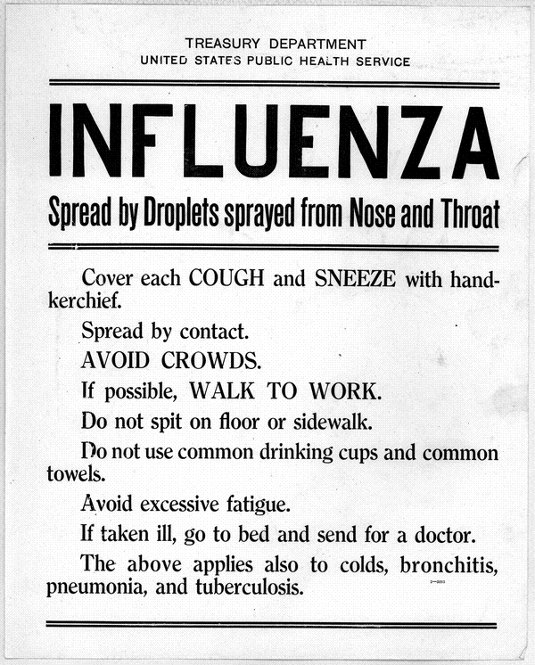
History Snapshots:
The Influenza Pandemic: a nation reacts
During the fall of 1918 and winter of 1919, the world was rocked by an epidemic of influenza known as the Spanish Flu. This strain was exceptionally lethal. While the
mortality rate is impossible to
establish, it is estimated that
675,000-850,000 Americans
died from influenza that year.
https://education.texashistory.unt.edu

Slide 3
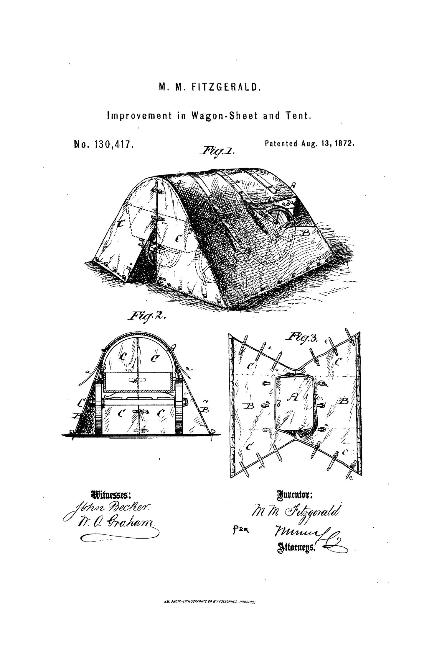
History Snapshot
The Influenza Pandemic of 1918-1919: What would you do?
Word Teach!
What do these words mean?
Influenza
Tuberculosis
Pandemic
Epidemic
What do you think would happen if most of your classmates came down with the flu. What if your town or even the entire state of Texas caught the flu?
Do think our response to the flu today would be different than what happened during the Influenza Pandemic of 1918-1919? To find out, complete the activity for this lesson.
https://education.texashistory.unt.edu

Slide 4

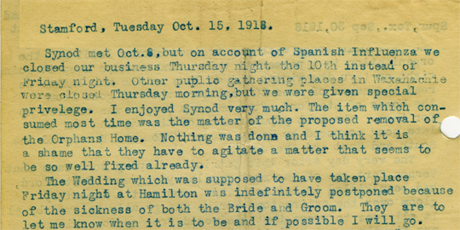
History Snapshots:
The Influenza Pandemic of 1918-1919: a personal account
This letter written by Rev. Dr. Thomas McHutchin Cunningham shows how the flu affected his town.
Rev. Cunningham, Thomas McHutchin. “Letters of Rev. Dr. Thomas McHutchin Cunningham.” 1918 to 1927.
Permalink: http://texashistory.unt.edu/ark:/67531/metapth24653/m1/30/?q=oct.%2015,%201918
https://education.texashistory.unt.edu

Slide 5
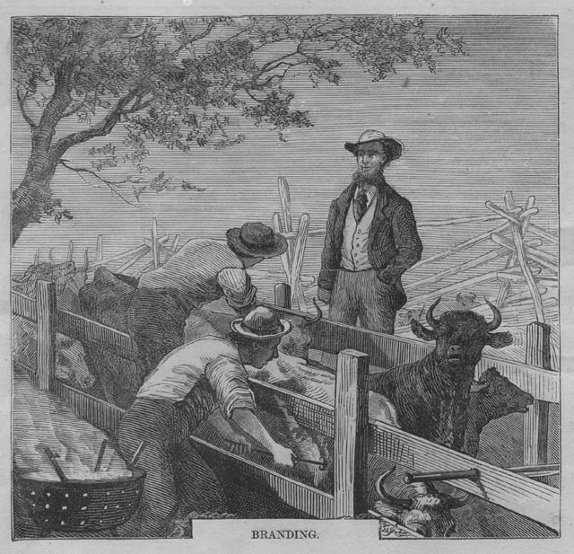
History Snapshots:
The Influenza Pandemic of 1918-1919: newspaper accounts
Students will examine newspaper articles published in 1918 during the flu epidemic to learn how a small Texas community responded to the pandemic.
For this Texas History Snap Shot students will need to view the Tulia Herald newspaper online by following the permalinks provided on slides 7, 8, and 9.
How to view the articles:
from the slide, click on the newspaper image
then click on the zoom link, located on the right side of the page
locate and read the article
https://education.texashistory.unt.edu

Slide 6
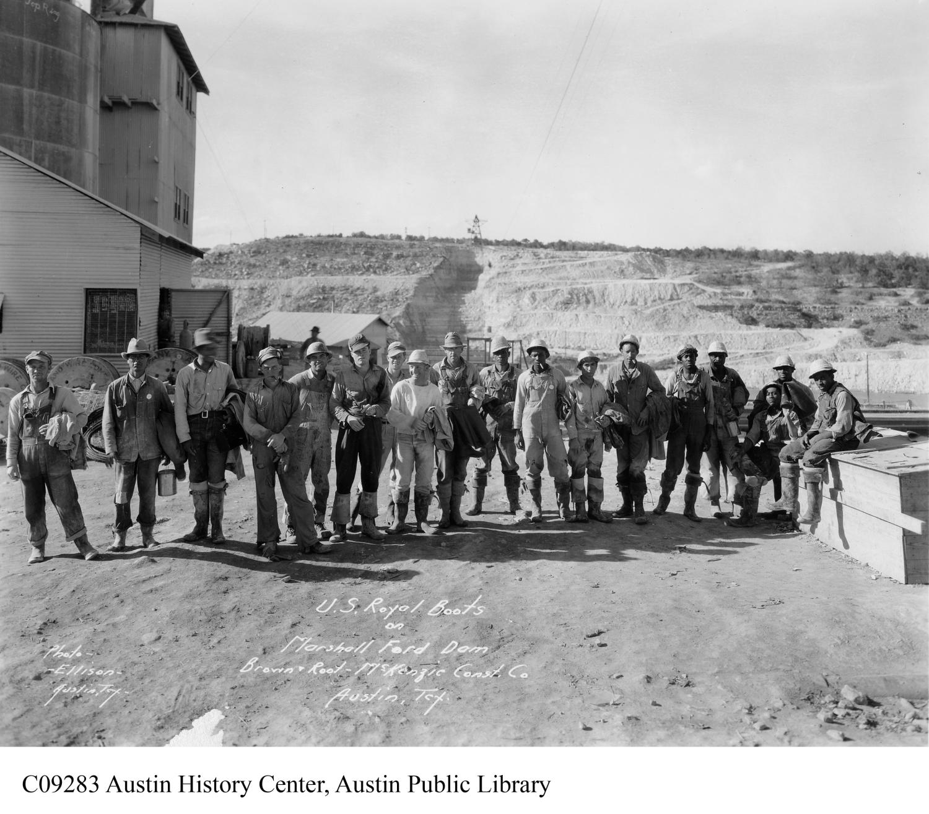
History Snapshots:
The Influenza Pandemic of 1918-1919: Considerations
Questions to consider as you read:
What are the concerns of the Tulia Herald issue of December 20, 1918, about the dangers of secondary infections?
How did the Influenza epidemic changed the nature of every day life for the citizens of Tulia?
Consider how the town handled the large number of infected citizens.
By 29 November 1918 how many citizens of Tulia were afflicted with Spanish Flu?
https://education.texashistory.unt.edu

Slide 7
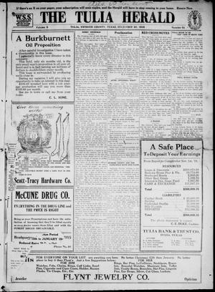
History Snapshots:
The Influenza Pandemic of 1918-1919: a Town Reacts
The Tulia Herald (Tulia, Tex), Vol. 9, No. 51, Ed. 1, Friday, December 20, 1918
Read the articles:
“After Influenza What?”
and “How to Avoid
Tuberculosis.”
Click on newspaper
https://education.texashistory.unt.edu

Slide 8
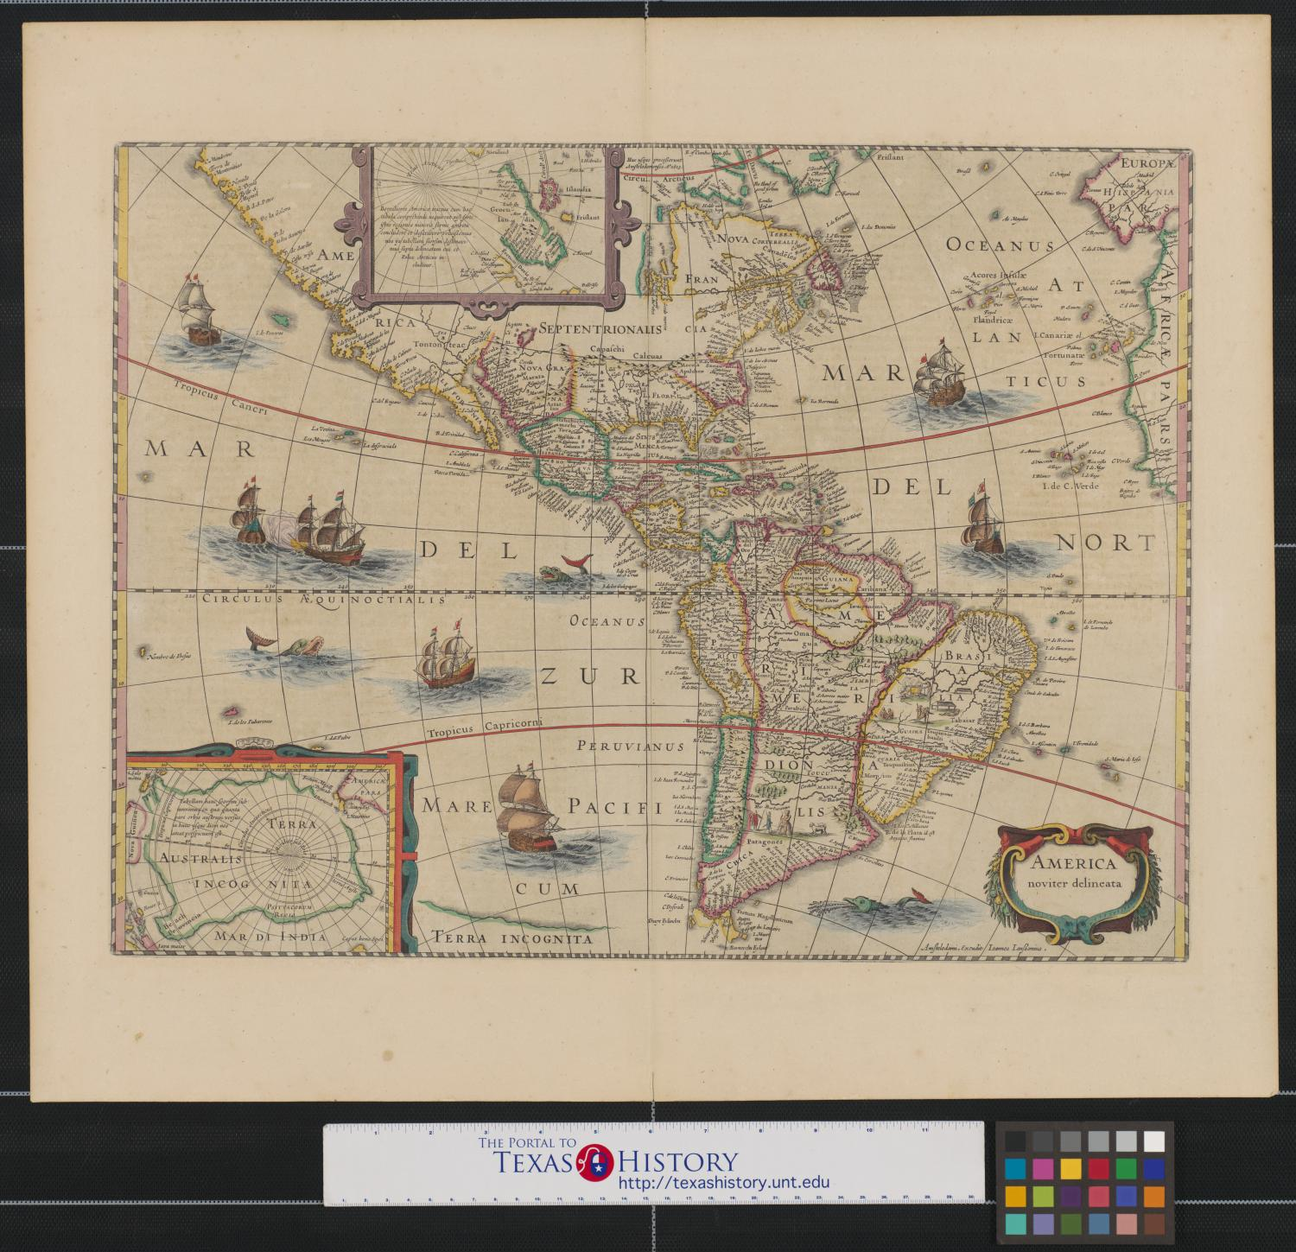
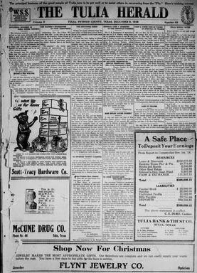
History Snapshots:
The Influenza Pandemic of 1918-1919: a Town Endures
The Tulia Herald (Tulia, Tex), Vol. 9, No. 49, Ed. 1, Friday, December 6, 1918
Read the articles
“The Influenza Siege” and
“Influenza Epidemic is Well
Under Control.”
Click on newspaper
https://education.texashistory.unt.edu

Slide 9
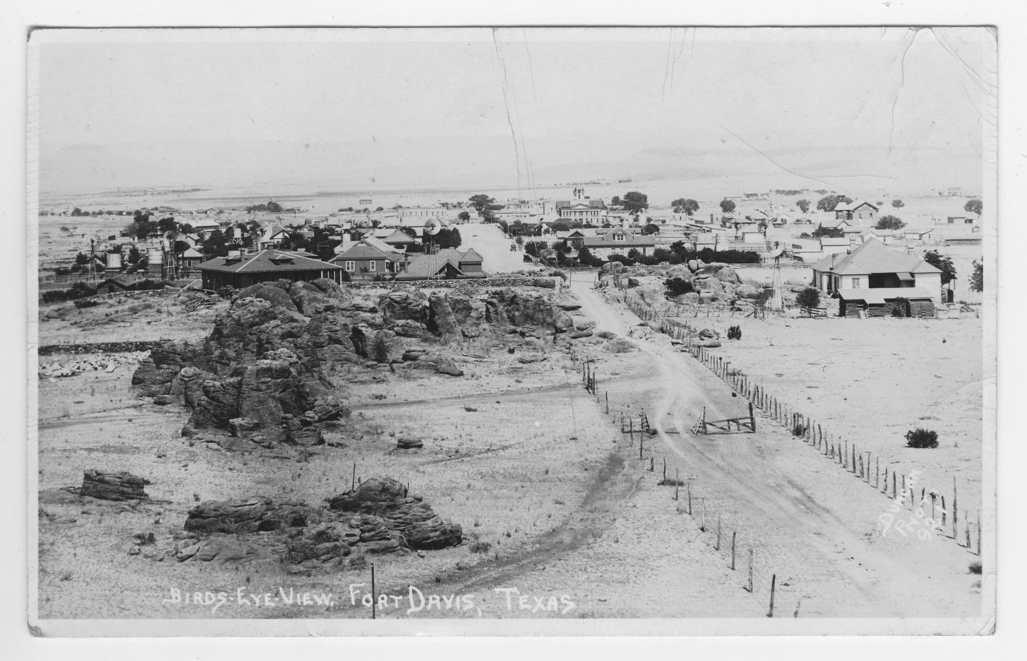
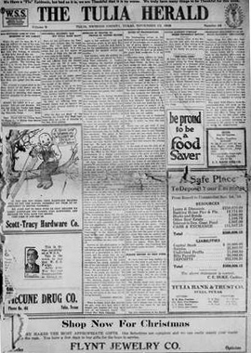
History Snapshots:
The Influenza Pandemic of 1918-1919: Tulia Affected
The Tulia Herald (Tulia, Tex), Vol. 9, No. 48, Ed. 1, Friday, November 29, 1918 (excellent)
Read the article
“Influenza Epidemic has Hit Tulia Hard Blow”
https://education.texashistory.unt.edu
Click on newspaper

Slide 10
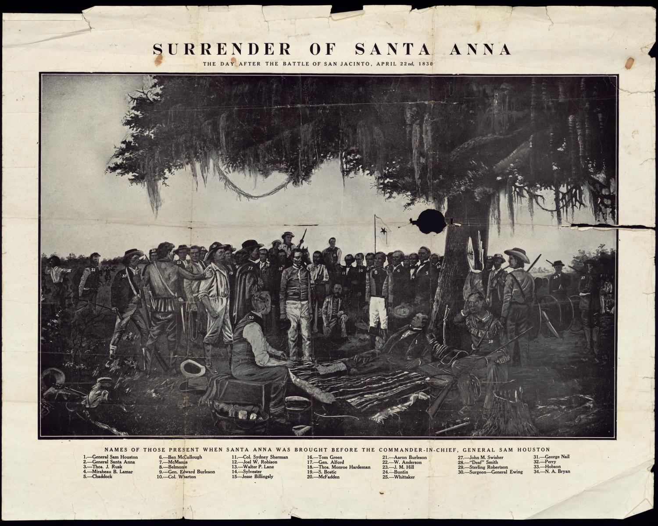
History Snapshots:
The Influenza Pandemic of 1918-1919: Learn More
Resources:
The Influenza Pandemic of 1918
http://virus.stanford.edu/uda/
The Navy Department Library: “The Pandemic of Influenza in 1918-1919” https://www.history.navy.mil/research/library/online-reading-room/title-list-alphabetically/i/influenza/the-pandemic-of-influenza-in-1918-1919.html
National Archives and Records and Records Administration: The Deadly Virus The Influenza Epidemic 1918. http://www.archives.gov/exhibits/influenza-epidemic/
CDC Emerging Infectious Diseases “1918 Influenza: the Mother of All Pandemics” https://wwwnc.cdc.gov/eid/article/12/1/05-0979_article
https://education.texashistory.unt.edu

