Slide 1

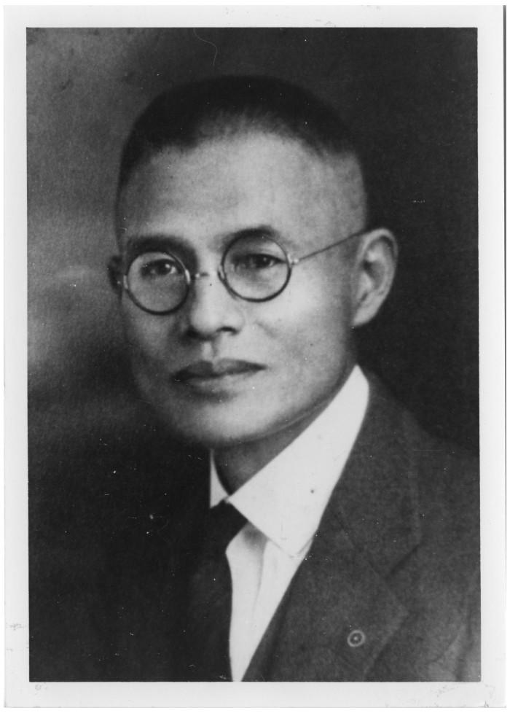
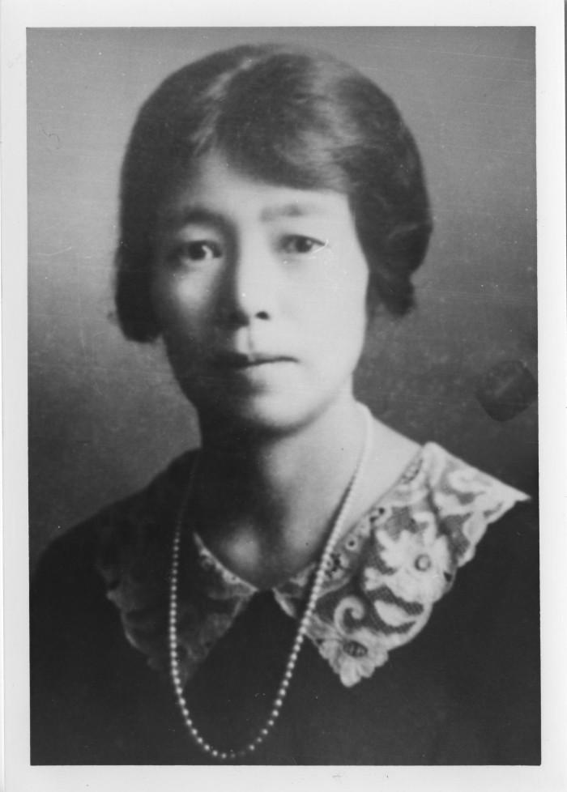
History Snapshots:
The Kishi Farm: Japanese Immigrants to Texas
The Kishis came to Texas in 1908. Kichimatsu Kishi was a successful businessman who founded a 3,500 acre rice colony at Terry, Texas on the Southern Pacific Railroad line between Orange and Jefferson Counties.
Kicimatsu Kishi and Fuji Kishi; crediting Heritage House Museum, Orange, Texas.
https://education.texashistory.unt.edu

Slide 2
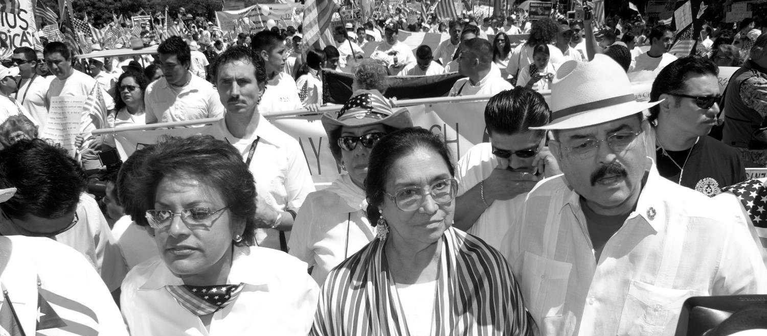
History Snapshots:
The Kishi Farm: Japanese Immigrants to Texas
The Kishis came to Texas in 1908. Kichimatsu Kishi was a successful businessman who founded a 3,500 acre rice colony at Terry, Texas on the Southern Pacific Railroad line between Orange and Jefferson Counties.
https://education.texashistory.unt.edu

Slide 3
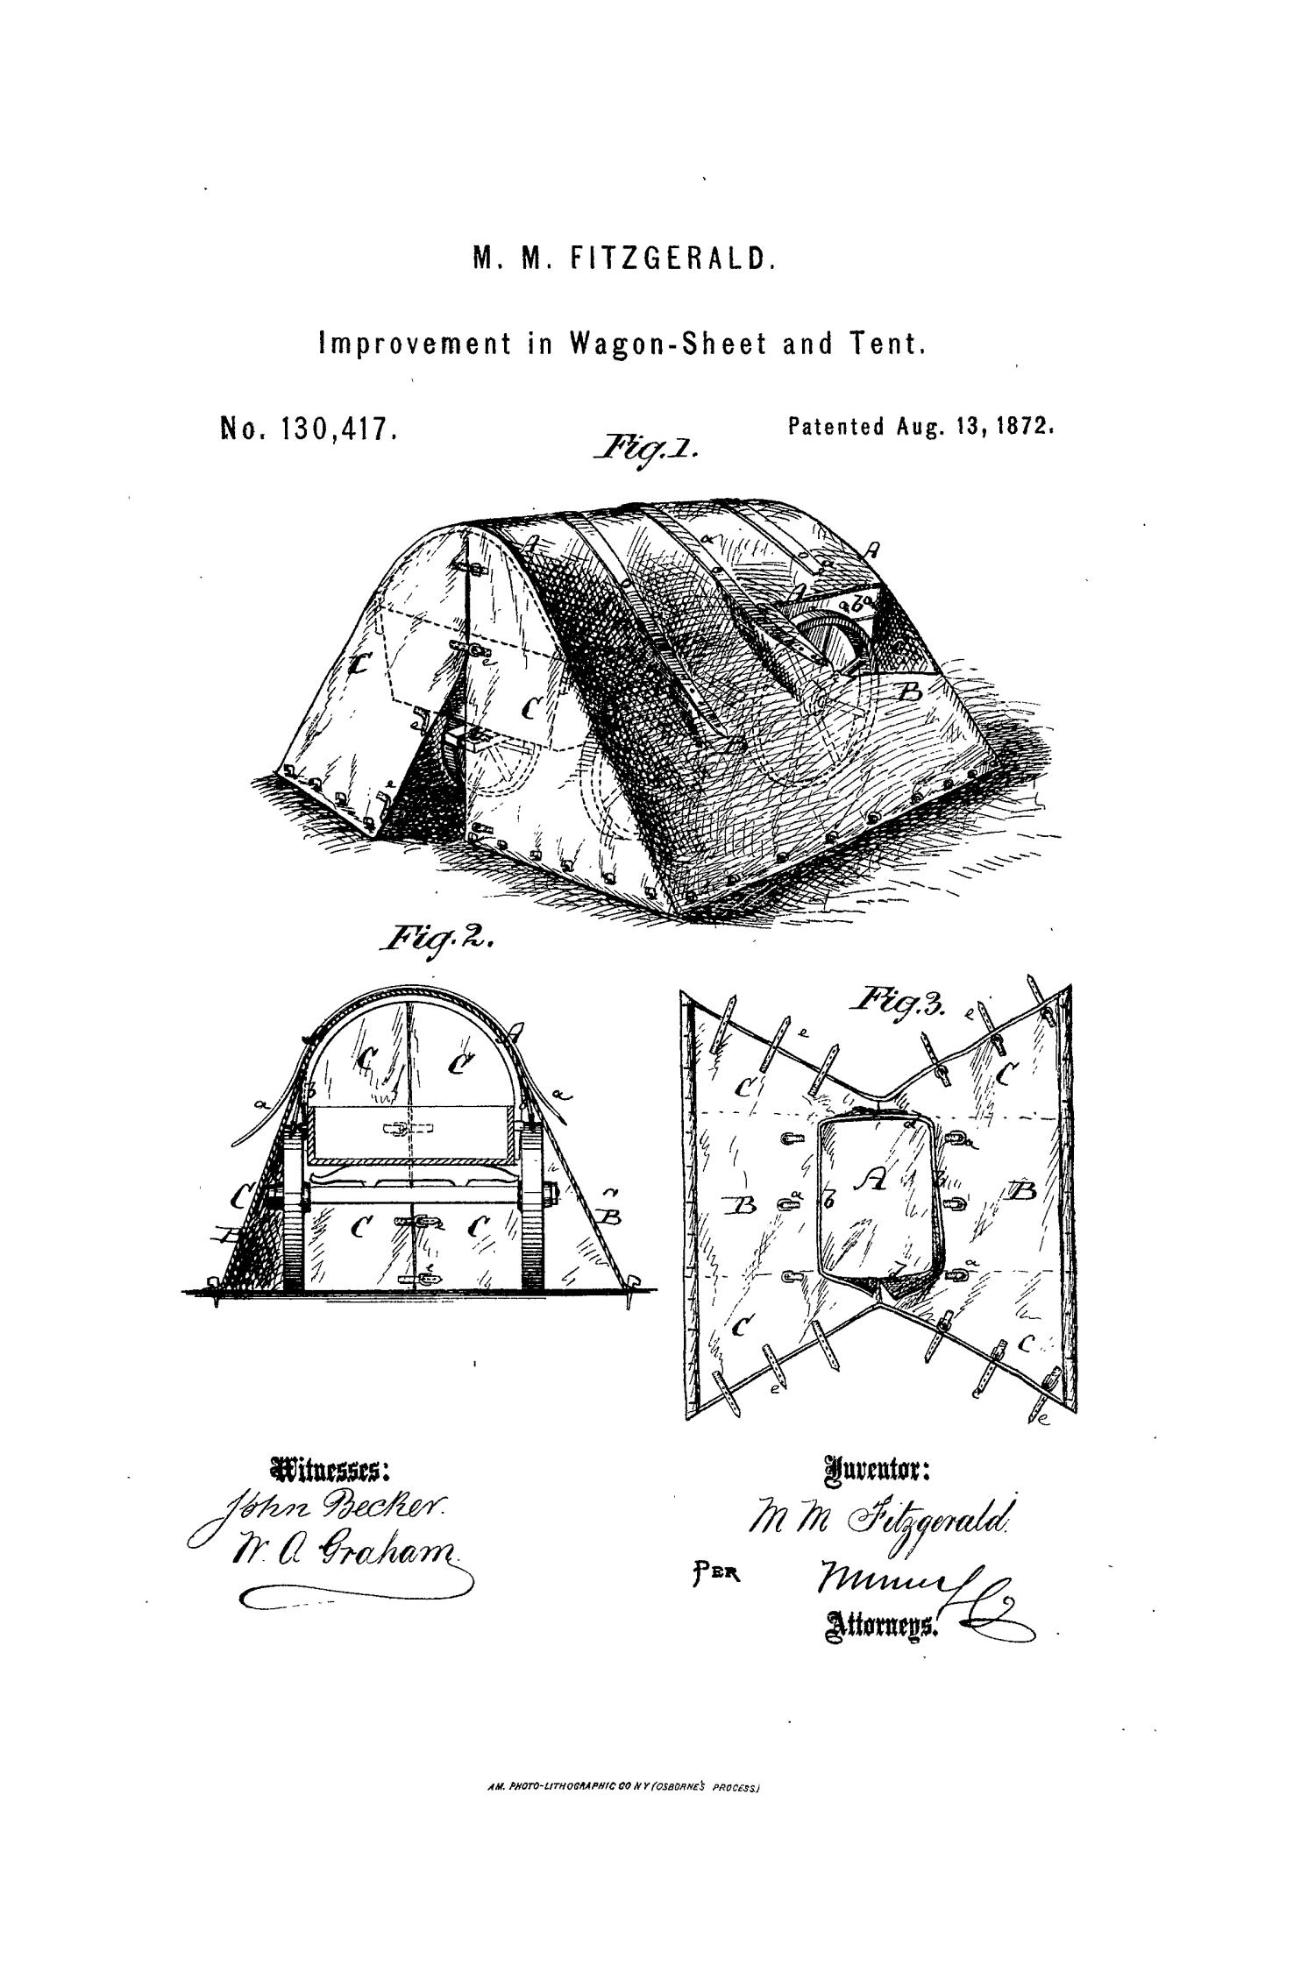
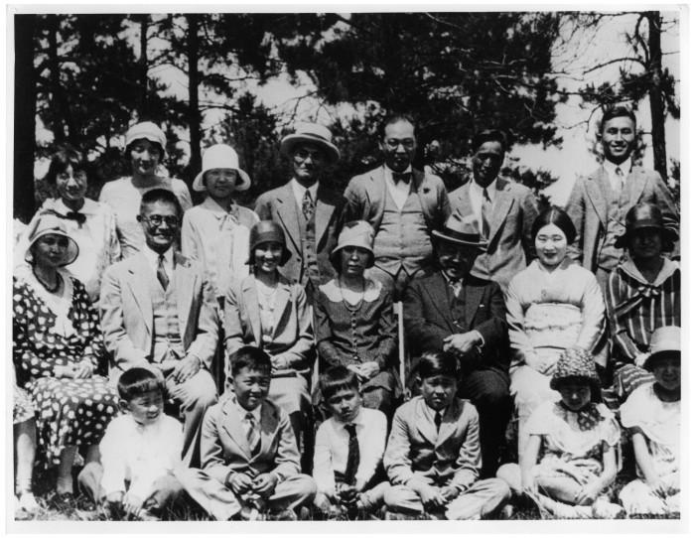
History Snapshot
The Kishi Farm: a growing rice colony
Kichimatsu Kishi is second from the left on the second row. The residents of Kishi Colony brought their families with them to begin new lives in Texas.
[Japanese Group Portrait], Photograph, n.d.; digital image, (http://texashistory.unt.edu/ark:/67531/metapth37172 ) ; crediting Heritage House Museum, Orange, Texas.
https://education.texashistory.unt.edu

Slide 4
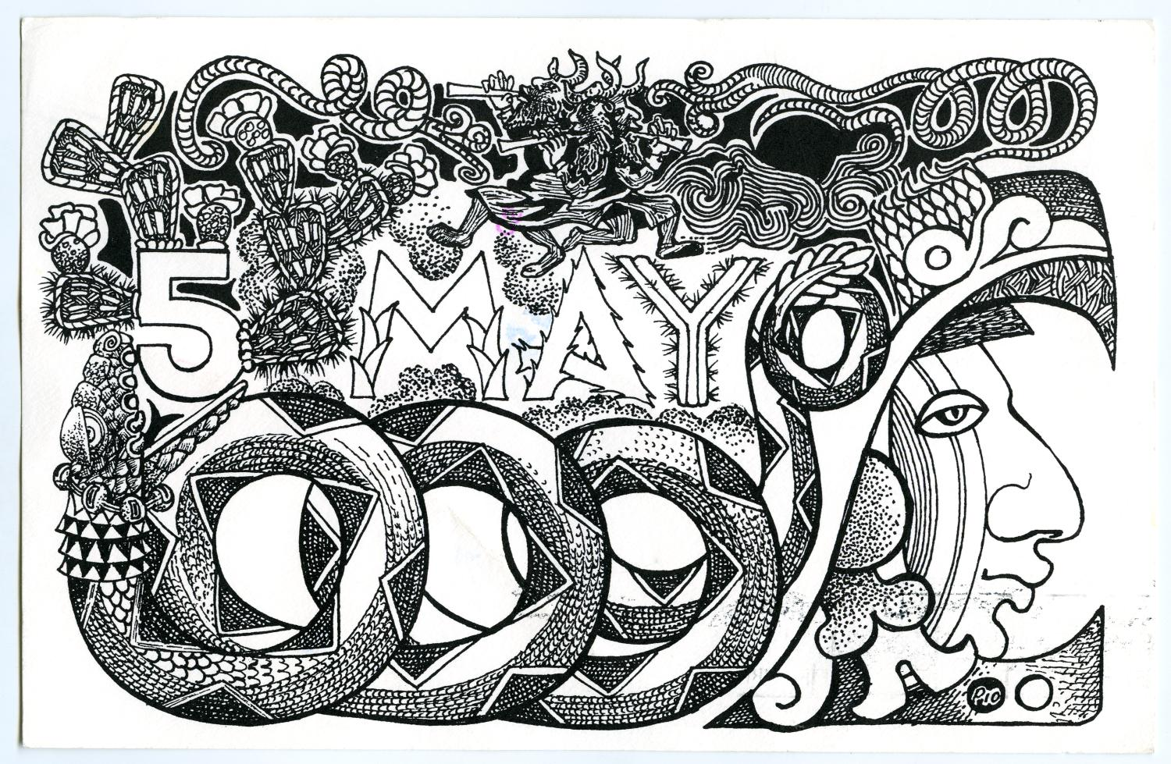
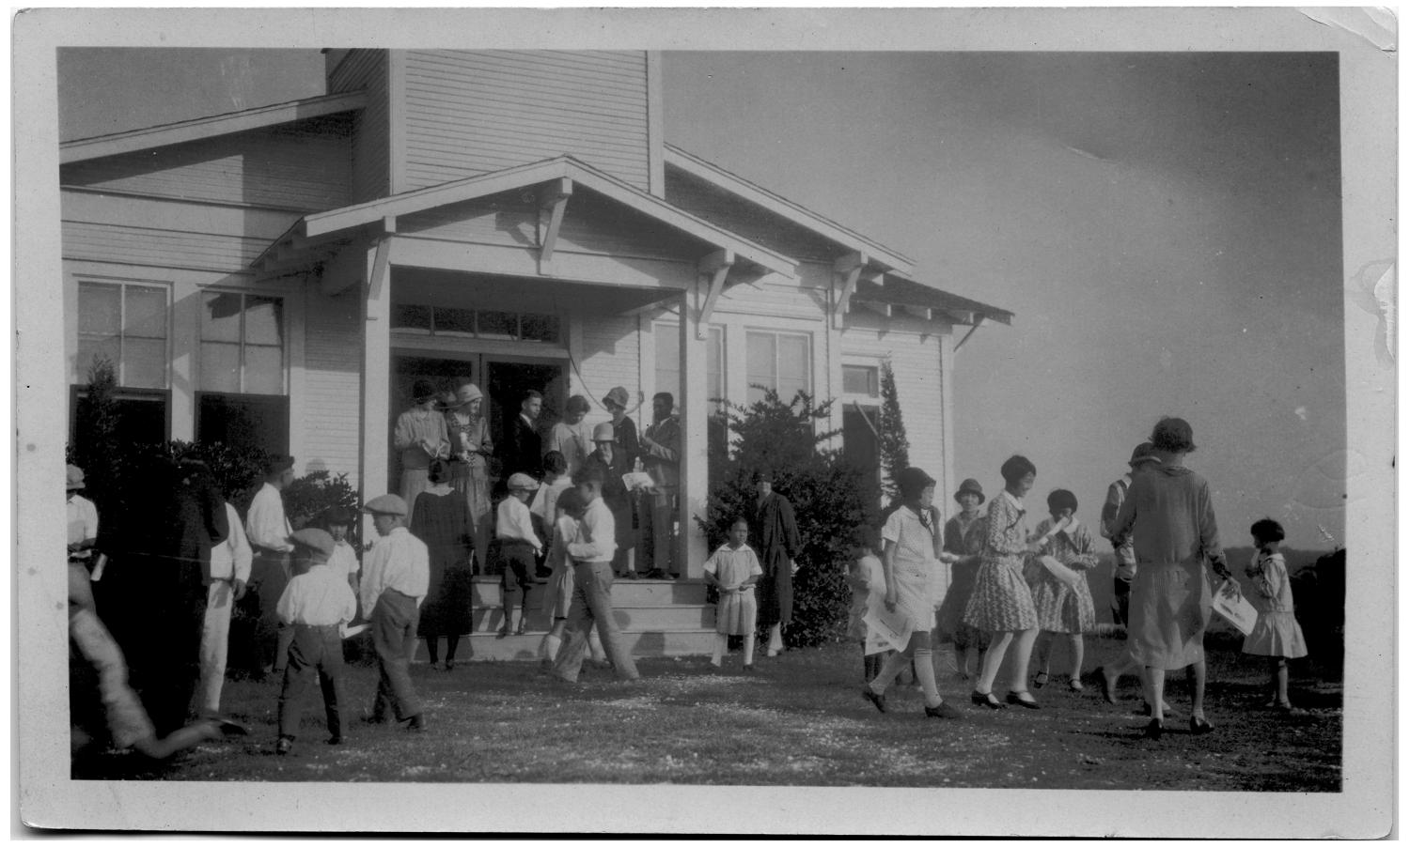
History Snapshots:
The Kishi Farm: building a community
The Kishi colony residents
became part of the Texas
Community building
homes and constructing a
church.
Methodist church at Terry, Texas, Photograph, ca. 1922; digital image, (http://texashistory.unt.edu/ark:/67531/metapth37171) ; crediting Heritage House Museum, Orange, Texas.
https://education.texashistory.unt.edu

Slide 5
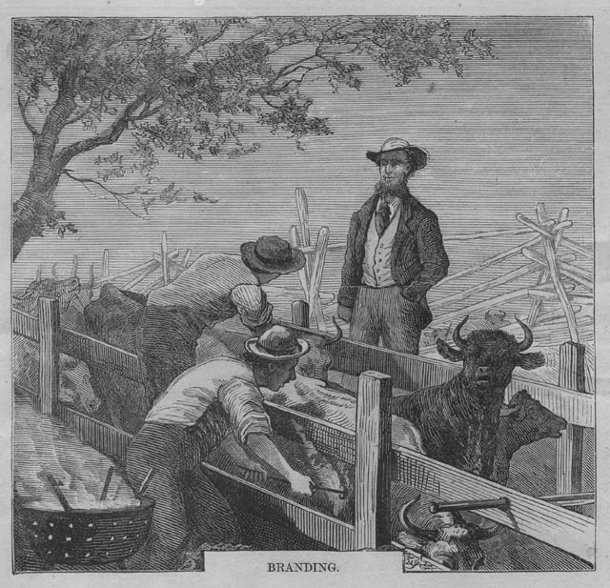
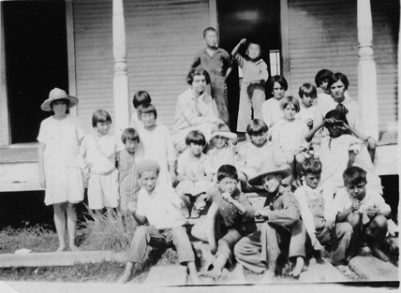
History Snapshots:
The Kishi Farm: a school for the community
Japanese immigrants of the
Kishi Colony and Anglo
children at the Terry School.
Terry Schoolchildren and Teachers, Photograph, n.d.; digital image, (http://texashistory.unt.edu/ark:/67531/metapth37169); crediting Heritage House Museum, Orange, Texas.
https://education.texashistory.unt.edu

Slide 6
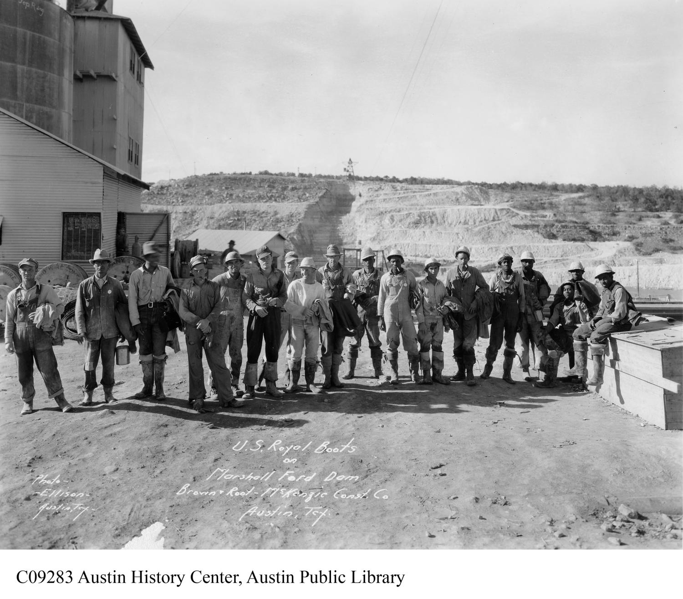
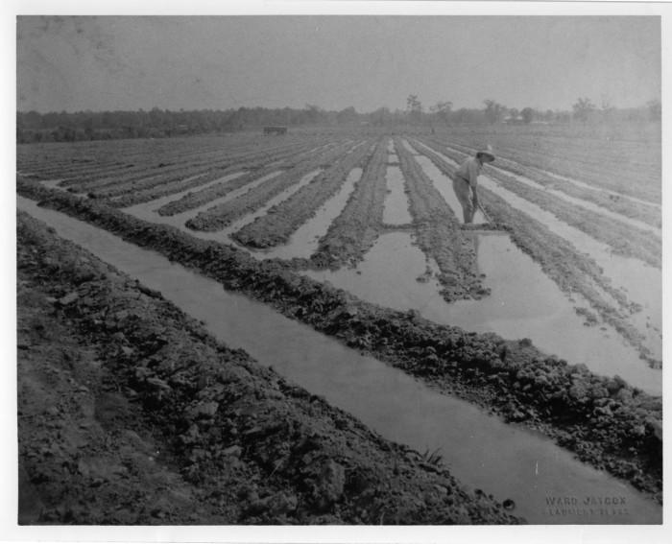
History Snapshots:
The Kishi Farm: Rice paddies in Texas
https://education.texashistory.unt.edu
[Laboring in the Rice Fields], Photograph, n.d.; digital image, (http://texashistory.unt.edu/ark:/67531/metapth37192 ); crediting Heritage House Museum, Orange, Texas.

Slide 7
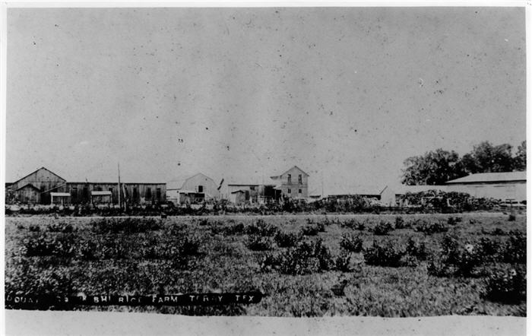
History Snapshots:
The Kishi Farm: the farm headquarters
[Kishi Rice Farm’s Headquarters.] Heritage House Museum. Photograph: B&W 5 x 7 in.
Permalink: http://texashistory.unt.edu/permalink/meta-pth-37176
https://education.texashistory.unt.edu

Slide 8
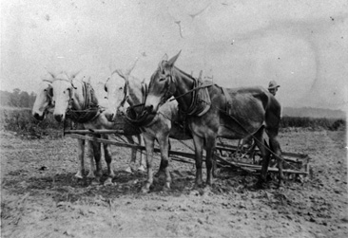
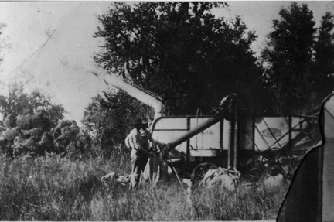
History Snapshots:
The Kishi Farm: Changes with technology
The Kishi Farm was
originally worked with draft
animals, such as these mules.
[Team of Mules Pulling Cultivator at Kishi Farm], Photograph, n.d.; digital image, (http://texashistory.unt.edu/ark:/67531/metapth37181); crediting Heritage House
However, technological progress saw draft animals replaced by mechanized farm equipment. Harvesters, such as the one pictured here, allowed rice to be collected more quickly and efficiently on the Kishi farm.
[Harvesting Rice at the Kishi Farm], Photograph, n.d.; digital image, (http://texashistory.unt.edu/ark:/67531/metapth37185 ); crediting Heritage House Museum, Orange,Texas.
https://education.texashistory.unt.edu

Slide 9
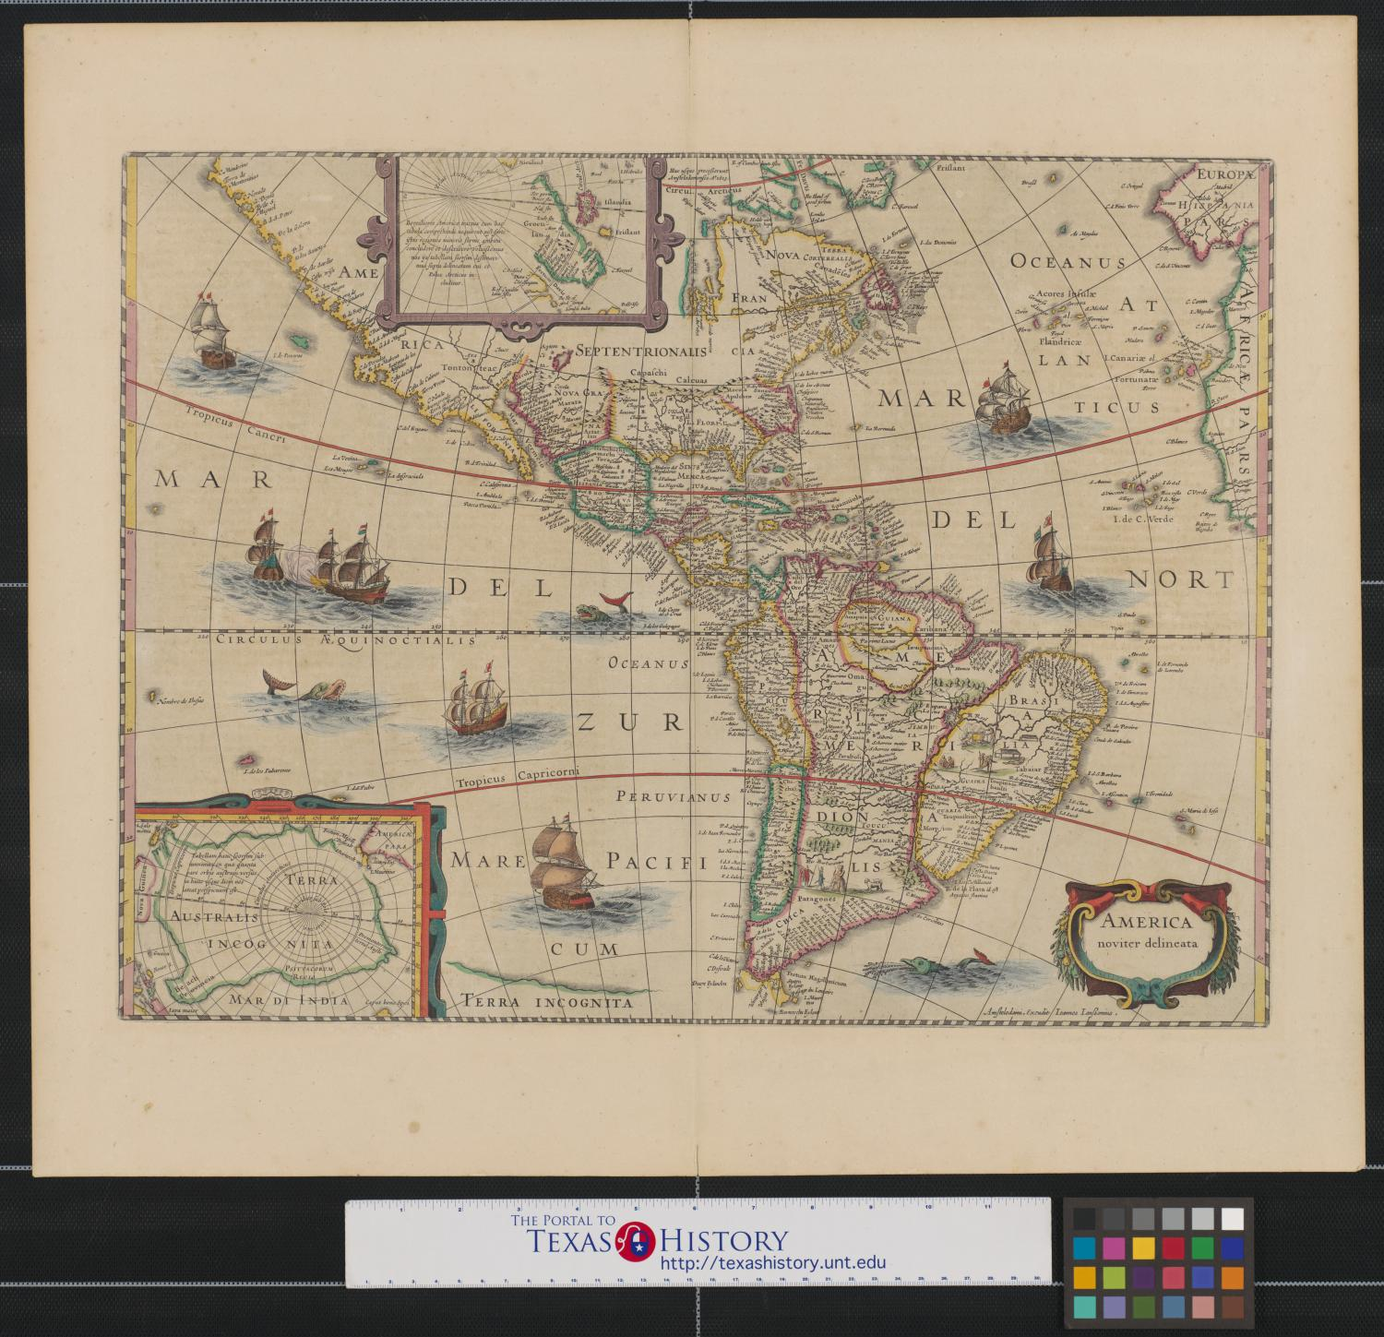
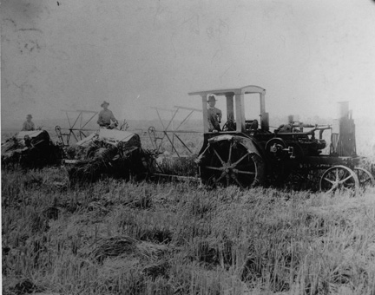
History Snapshots:
The Kishi Farm: Harvesting rice
Kichimatsu Kishi in the rice rields with laborers.
Kichimatsu drives a tractor harvesting rice
on his 3,500 acre farm, with two farmhands working alongside.
[Kichimatsu Kishi in the Rice Field with Laborers.] Photographic: B&W: 8 x 10 in.
Permalink: http://texashistory.unt.edu/permalink/meta-pth-37189. crediting Heritage House Museum.
https://education.texashistory.unt.edu

