Slide 1

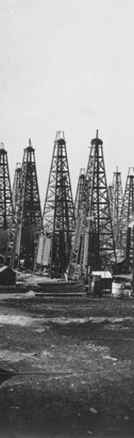
Black Gold: Texas Oil
The discovery and development of Texas oil and natural gas fields was a continuing economic boon to Texas. It allowed economic diversification, establishing a Texas industrial base with the construction of oil fields, pipelines, refineries, railroads, port facilities, and their attendant support industries. The Texas “oil boom” also wove itself indelibly into the fabric of Texas culture and myth.
https://education.texashistory.unt.edu

Slide 2
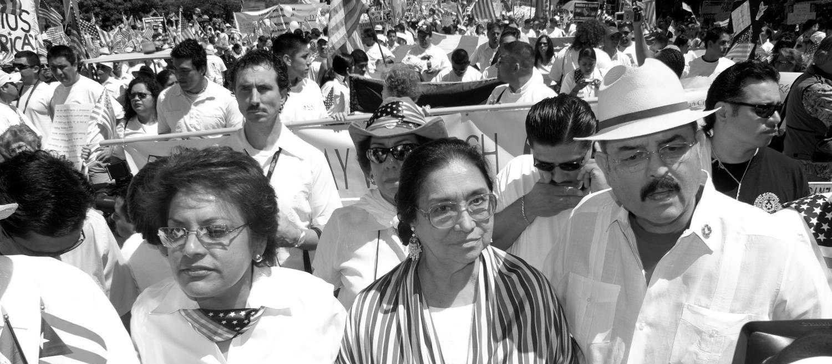
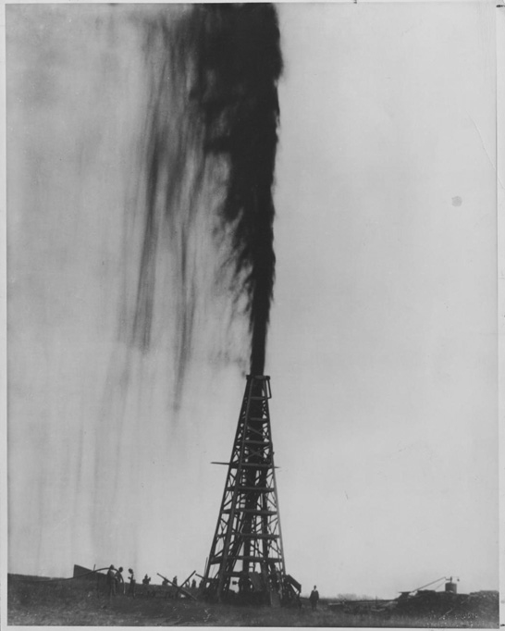
Black Gold: Texas Oil
Spindletop
Spindletop: The Lucas Gusher, January 10, 1901
Oil “black gold” erupted 150 feet in the air from the Lucas Gusher near Beaumont, Texas. The well was not capped for nine days and lost an estimated 850,000 barrels of oil. It produced an estimated 75,000 barrels of oil a day. Peak annual production was 17.5 million barrels in 1902.
The Lucas Gusher, 1901. Photograph 11.25 in. x 14 in. University of Texas at Arlington Libraries, 1901.
Permalink: http://texashistory.unt.edu/permalink/meta-pth-41398
https://education.texashistory.unt.edu

Slide 3
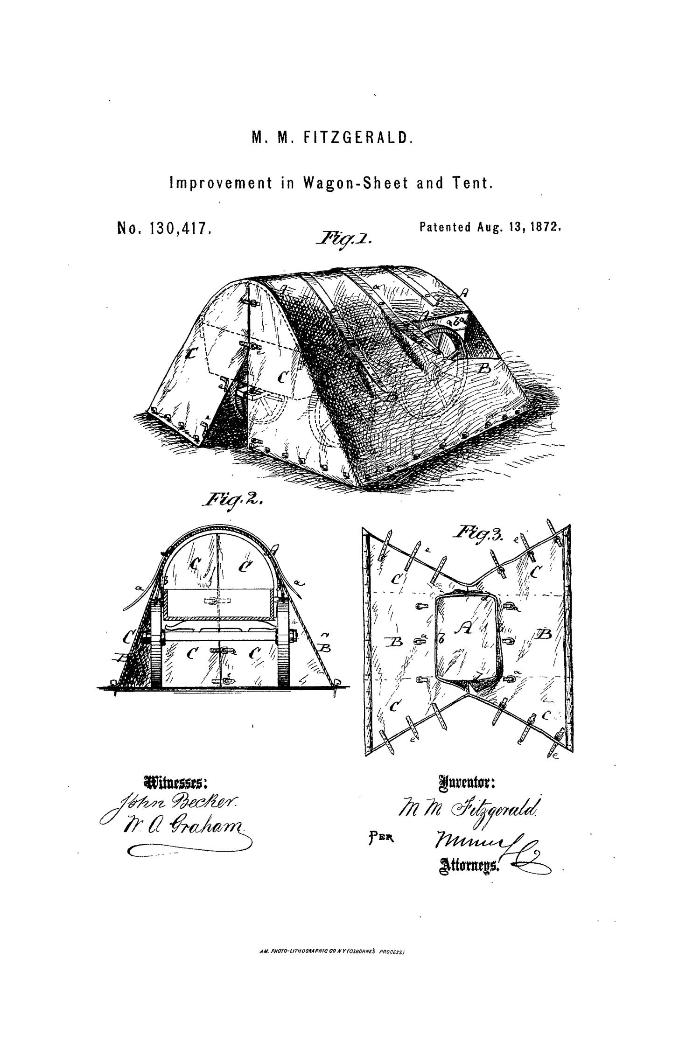
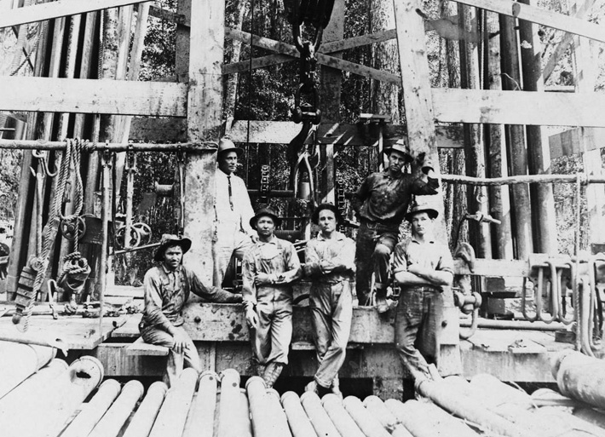
Black Gold: Texas Oil
Oilmen in the field
Oilmen at the Orangefield during the 1910s.
Oilmen posing in front of a wooden oil derrick surrounded by pipes and tools.
“Men with Oil Derrick.” Photograph B&W: 5.25in. X 3.5 in. Heritage House Museum.
Permalink: http://texashistory.unt.edu/permalink/meta-pth-37097
https://education.texashistory.unt.edu

Slide 4

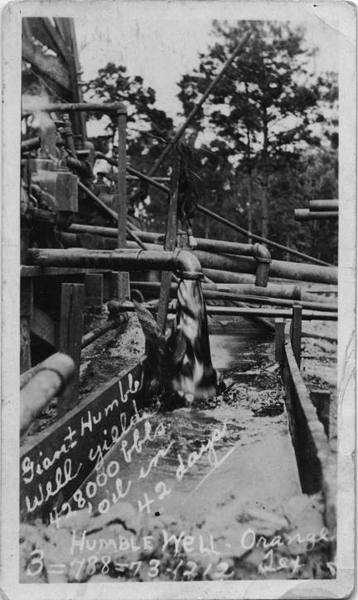
Black Gold: Texas Oil the Humble oil well
Humble oil well in Orange, Texas in 1920
Oil flowing from the Humble well to storage facilities. Note the rather crude pipe and sluice design used to funnel oil from the well to holding facilities. The Humble well yielded 428,000 barrels oil in 42 days.
https://education.texashistory.unt.edu
“Oil Flowing from Humble Well” Postcard B&W: 3 3/8 in. x 5 ½ in. Heritage House Museum.
Permalink: http://texashistory.unt.edu/permalink/meta-pth-37219

Slide 5
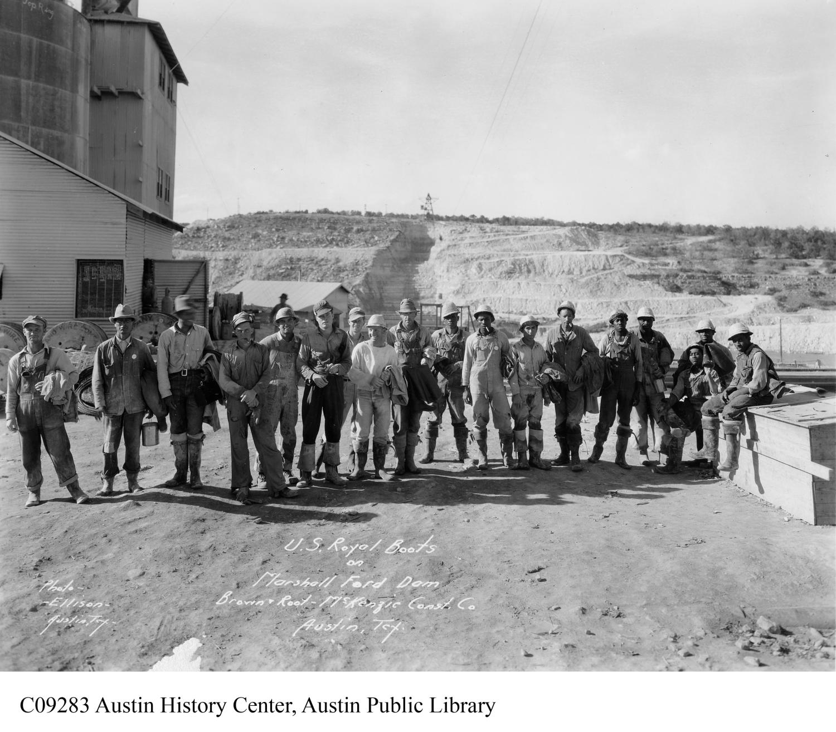
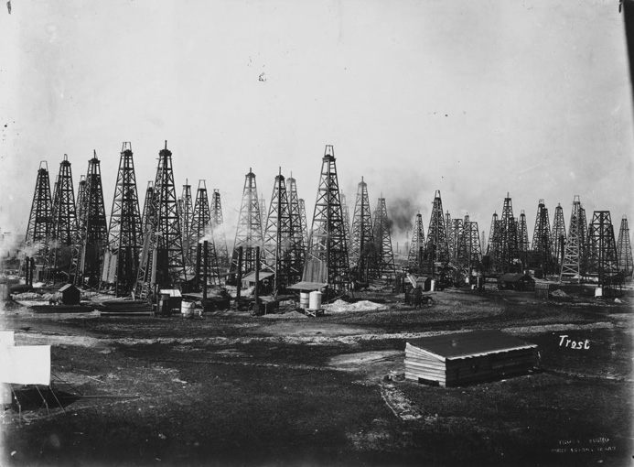
Black Gold: Texas Oil
The oil field boom
Spindletop Oil Field during the boom years of 1910s.
A depiction of the crowded nature of oil fields during the Oil boom. 500 wells were drilled on 144 acres. Large and small businessmen wanted to make their fortune. The burgeoning oil industry was the Texas equivalent of the California gold rush.
Oil Field in Beaumont, Texas 1901. Photograph B&W 14 in. x 10 in. University of Texas at Arlington Libraries.
Permalink: http://texashistory.unt.edu/permalink/meta-pth-41397
https://education.texashistory.unt.edu

Slide 6
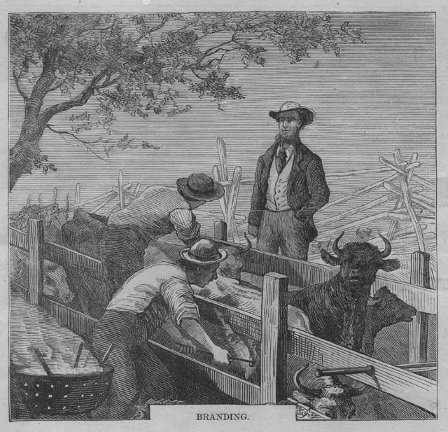
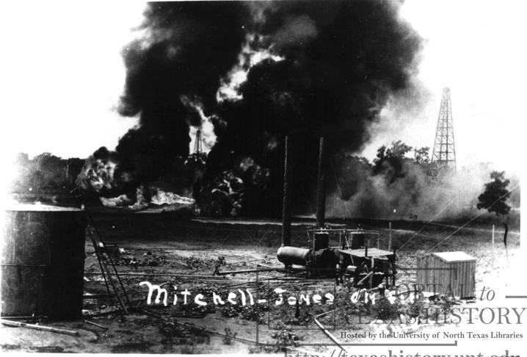
Black Gold: Texas Oil
Fire in the fields!
Fire at the Petrolia Oil Field
The 1910 fire at Mitchell-Jones oil well in Petrolia, Texas. Fires and Explosions were a constant danger in oil fields.
“Men with Oil Derrick.” Photograph B&W: 5.25in. X 3.5 in. Heritage House Museum.
Permalink: http://texashistory.unt.edu/permalink/meta-pth-37097
https://education.texashistory.unt.edu

Slide 7
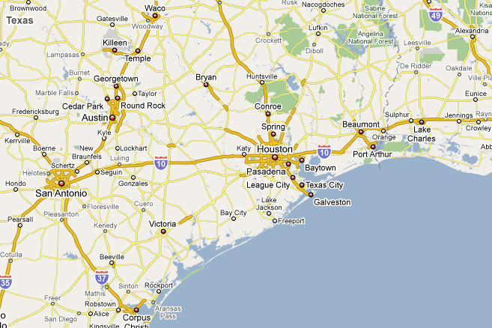
Black Gold: Texas Oil
Find the town
The oil fields covered in this lesson were located in Beaumont and Orange, Texas. Can you find these towns on the map?

